Slide 1
Accessibility Series: Part 2
Lindsay Bryde
Glenn Dausch
Robert Petrik

Slide 2
Overview
Describe accessibility best practices,
Apply best practices with demonstrations in Microsoft tools.
  Note: all best practices (e.g., headings, alt text) apply to Microsoft, Google, and web content.
Discuss how to check multimedia content.
Explain exceptions to Title II for digital content.
List resources and tools for evaluating or remediating web content.

Slide 3
Microsoft Tools Overview

Slide 4
General Word/PPT Accessibility Guidelines
Use Sans Serif or easy to read Serif fonts.
  Recommended fonts: Tahoma, Verdana, Garamond, Cambria (all are Sans Serif), Arial, Times New Roman (Serif)
  At least 12 pt
Minimize use of bold, underline, italic.
Left justify text.
Keep paragraphs brief with sufficient white space between lines.
Don’t place critical information in headers, footers, or notes. That information should be repeated in the main text or slide.
Alert users that comments are present, if needed.

Slide 5
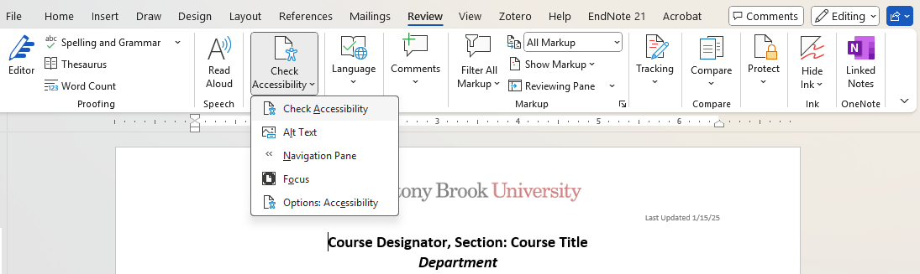
Finding Microsoft’s Accessibility Assistant
In the Word toolbar click Review>Check Accessibility.

Slide 6
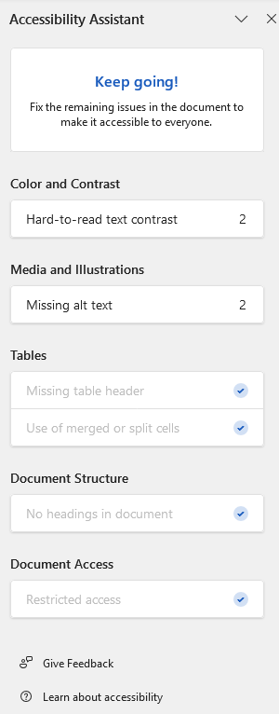
Accessibility Assistant
The checker looks for major accessibility barriers:
              Poor color contrast
              Missing alt-text
              Table errors
              Missing heading structure/duplicative slide titles
The checker does NOT look for:
  Long descriptions of images
  Language settings
  Descriptive hyperlinks
  Closed Captions of embedded videos (it will prompt you to manually check in the Assistant)

Slide 7
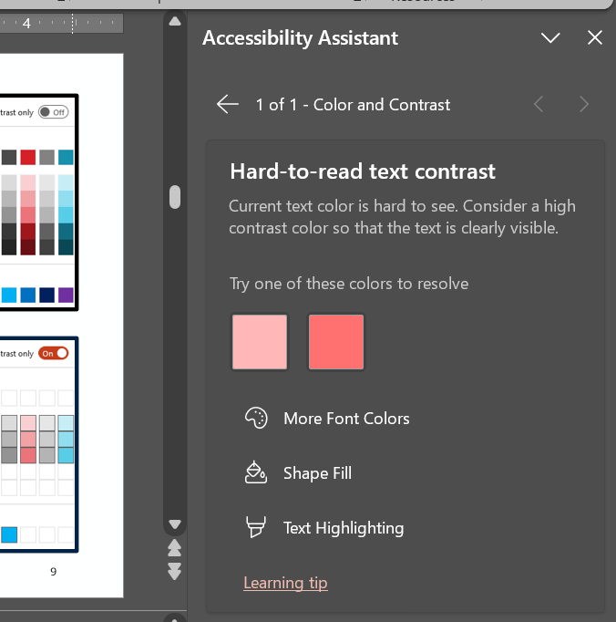
Accessibility Assistant Report
The report is broken down into categories specific to the tool (e.g., Word, PPT, Excel).
If there’s an issue, the criterion is a selectable link with a number next it (indicating how many instances of the issue are detected).
When a problem is identified, select that criterion for the Assistant to:
  Explain why it matters
  Show where it is
  Offer a one‑click fix or a guided step-by-step

Slide 8
Descriptive Hyperlinks
Best Practices
Keep It Simple: use concise and meaningful text for links; don’t drop the whole URL for link text.
  Example: For additional information about the new Department of Justice Rules on Accessibility, visit The ADA's Fact Sheet.
Provide Context in Surrounding Text: when possible, place links within context that provides additional information.
Avoid repetition: avoid using the word "link" as part of the link text or repeating the same phrase for every link.
Notes:
Source: New York State Department of Education. (n.d.). Create Accessible Hypertext Links. https://www.nysed.gov/webaccess/create-accessible-hypertext-links

Slide 9
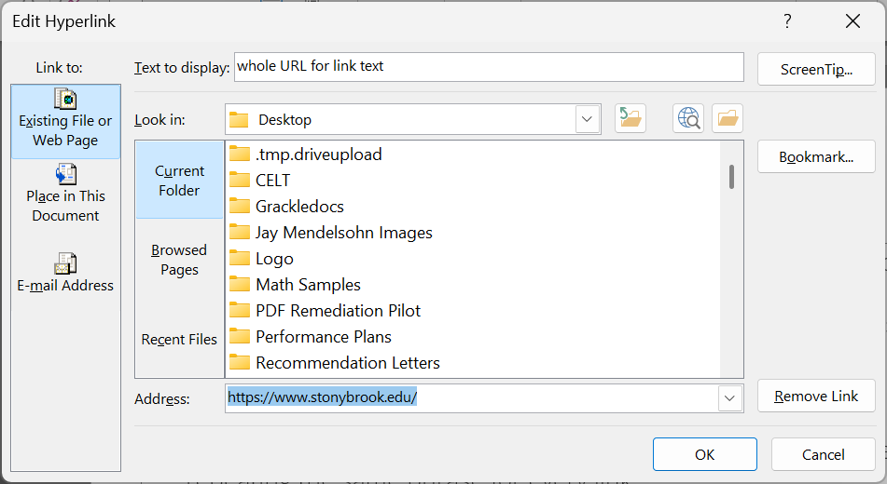
Links in Microsoft
Distinguish from surrounding text with blue color and underline.
Include meaningful link text in “Text to Display.”
Add Screentips if the link needs more context/instructions.

Slide 10
Alt Text
Best Practices
Describe the content and function of the image clearly; include any details that convey the image's purpose.
Aim for a brief description (e.g., 125-150 characters).
Use complete sentences or phrases and appropriate punctuation to enhance clarity.
Address how the image relates to the surrounding content.
Avoid redundant phrases like “Image of” or “Picture of.” Only include a description of image type if it helps visualize the content or understand the meaning of it (e.g., a particular style of artwork, like an illustration or diagram).
Arizona State University’s Image Accessibility Generator can help you get started.

Slide 11
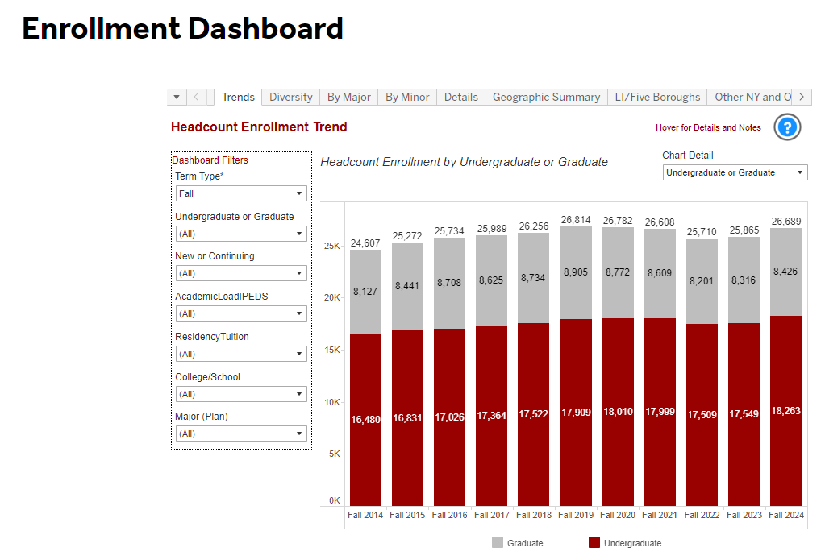
Long Description
When alt text does not provide enough detail
Provide long descriptions for images when it’s necessary to convey detailed information or when the user specifically requests a thorough explanation – commonly needed for images related to STEM fields.
Helpful when more context is necessary or a user has a visual impairment.
  For example, if an image contains complex elements, multiple objects, or important details that need to be understood clearly.

Slide 12
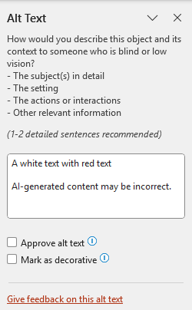
How to Add Alt Text
Images should have alt-text or be marked as decorative.
More complex images need long descriptions.
Alt Text editor is in the Picture Format section of the ribbon (which opens when you click on any image).
Suggested alt-text for screenshot of the text on this slide

Slide 13
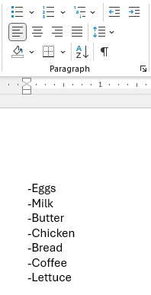
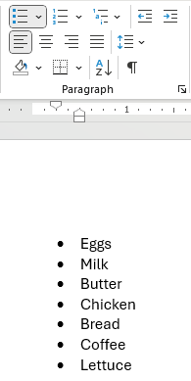
Lists and Columns
List and columns should be made using the lists and columns tools in Word.
The list or column feature will be highlighted when hovering over the text if used correctly.
List tools are in the Home section of the ribbon; columns are in the Layout section.

Slide 14
Tables
Are these tables accessible?
  Designate header row
  (and column if applicable).
  No split or merged cells.
  No empty cells.
  A title or caption should be above or below.
    This needs to be checked manually.
Assignment | Draft Due Date | Final Due Date
Essay 1 | 9/15 | 10/10
Essay 2 | 10/31 | 11/27
Final Essay |  | 12/23
Course Schedule
Module | Dates
1 | Weeks 1-2
2 | Weeks 3-4
3 | Weeks 5-6

Slide 15
Color Contrast
You’re a star!
High contrast between text and background makes it easier to read, especially for people with visual impairments or in low-light conditions.
You need color and text to convey what colors are signifying.
The color of link text must be different from plain text, and include an underline, italic, or bold.
Use “high contrast only” option in Word.
Use the WebAim Color Contrast Checker for manual check.
You’re a star!

Slide 16

Logos and University Branding
WCAG Guideline 1.4.3: Contrast (Minimum) (Level AA)
Success Criterion: The visual presentation of text and images of text has a contrast ratio of at least 4.5:1, except for the following: text that is part of a logo or brand name has no contrast requirement.
The university’s logo is exempt.
When the university colors are in plain text, they are not exempt.
Check color combinations closely – especially when using Secondary Colors.
  For example, Stony Brook Royal Blue on Stony Brook Turquoise is not sufficient:
Check Secondary Color Combinations Closely

Slide 17
Microsoft Word

Slide 18
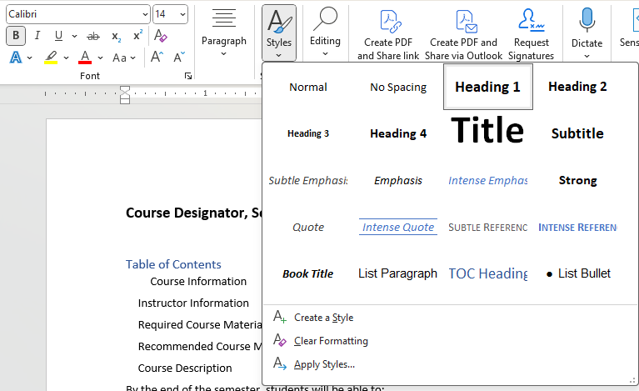
Headings & Heading Styles
Headings provide visual context for content and help direct assistive technology users in the document:
  Header 1 <h1> is for the main title
  Header 2 <h2> is for major sections
  Header 3 <h3> is for subsections.
You can modify styles and set your own defaults (link to Microsoft tutorial page).

Slide 19
Navigation Pane
See the headings in an outline format using the Navigation Pane:

Slide 20
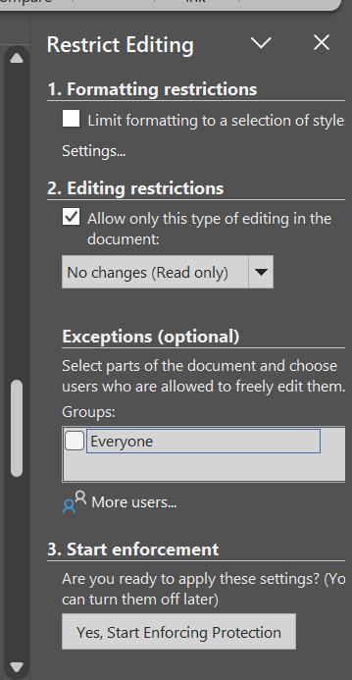
Restrict Editing
  If you need a read-only copy of the Word document, it’s best to Restrict Editing:
  Go to the Review>Restrict Editing.
  In Restrict Editing pane, Go to 2. Editing restrictions section and:
    Check the box: "Allow only this type of editing in the document."
    Select No changes (Read only) option from the drop-down menu.
  Go down to section 3. Start enforcement and click the button Yes, Start Enforcing Protection.

Slide 21
Microsoft PPT

Slide 22
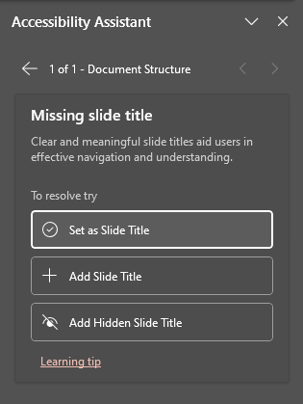
Slide Titles
Slide titles help assistive technology navigate the deck.
Every slide needs to have a title.
Accessibility Assistant will prompt you to resolve the issue by either:
  Setting an existing textbox as the slide title
  Adding a new textbox
  Adding a hidden slide title (e.g., when a picture or video takes up the whole slide, a title can be added above the slide)

Slide 23
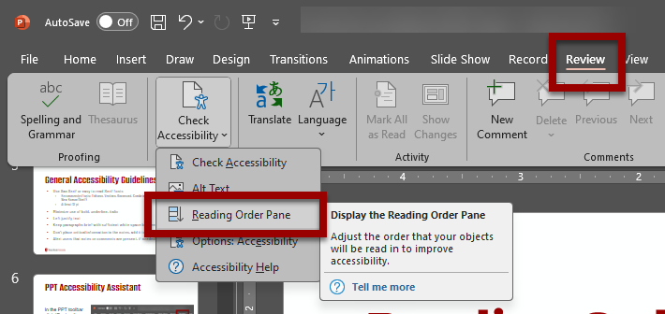
Reading Order
A slide’s reading order ensures that content is presented meaningfully and is easily navigable with assistive technology
Go to the “Review” ribbon, use the drop-down menu below “Check Accessibility,” and select the “Reading Order Pane” to open

Slide 24
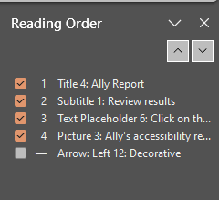
Reading Order cont’d
The slide title should always be first on the list.
Order textboxes and pictures in the order they should be read or navigated to via keyboard
  They can be moved using drag and drop or the up and down arrows in the pane
Remove any empty textboxes not being used.
If a box next to an item is unchecked, it’s been marked as decorative
Tip: click on any picture to add alt text while checking the reading order.

Slide 25
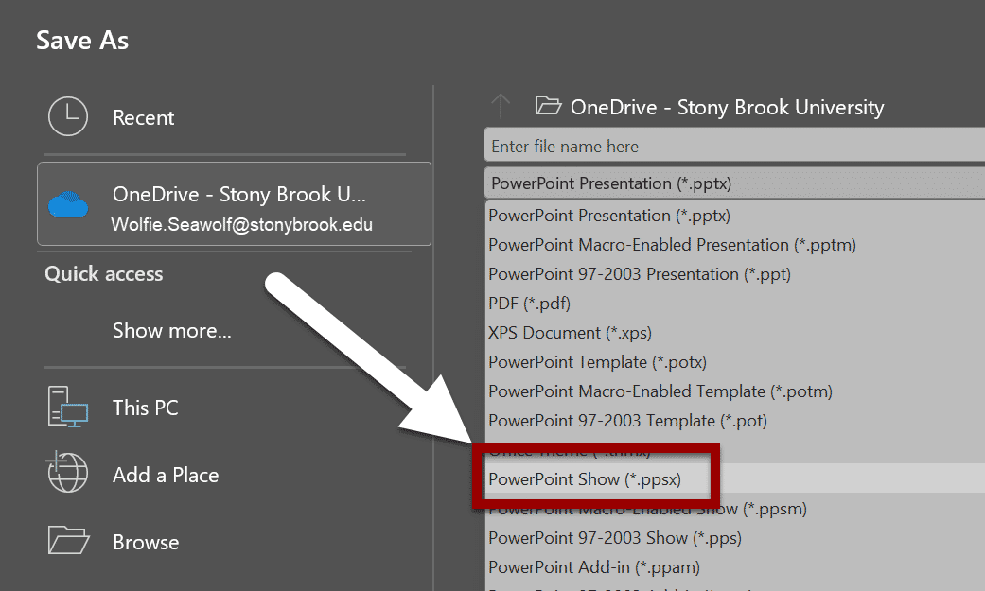
PowerPoint Show
PowerPoint Show maintains the reading order and alt while allowing users to benefit from the Presenter View and built-in magnification tools.
Go to the File tab and select Save As.
Click Browse to choose where you want to save the file.
In the Save as type dropdown menu, scroll down and select PowerPoint Show (*.ppsx).
Click Save.

Slide 26
Grackle
Notes:
Make this fill in the blank review- key tip for each topic in LOs (if needed)

Slide 27
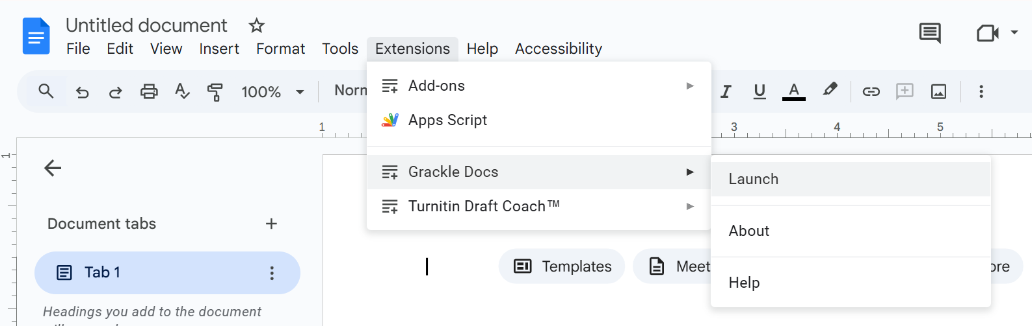
Grackle Workspace
An extension that checks Google Docs, Slides, and Sheets content
Click Extensions>Launch Grackle Docs to open the report.

Slide 28
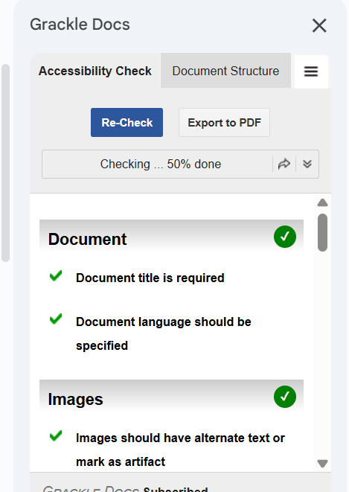
Grackle Cont’d
What Grackle Workspace does:
  Checks Google Doc for accessibility issues against technical standards (e.g., WCAG) and offers “recommended” remediations
  Offers step-by-step guidance or "click-and-fix" tools to resolve issues
  Allows you to create a PDF that preserves the accessibility information
What Grackle Workspace does NOT do:
  Fix all errors automatically
  Scan non-Google files
  Check the accuracy of alt text, heading structure, links, etc.

Slide 29
Video

Slide 30
Multimedia
Do not use blinking or flashing multimedia.
  It can cause seizures in individuals with photo-sensitivity.
Use animation when it helps convey a concept; not to draw attention to an unchanging object.
Check that all videos (e.g., YouTube, TedTalks) have closed captions and all audio-only content (e.g., podcasts) have transcripts.
Check captions and transcripts for accuracy (at least 98% minimum).
Do not set videos to automatically play when a page loads.
  Users need to be able to control the player.

Slide 31
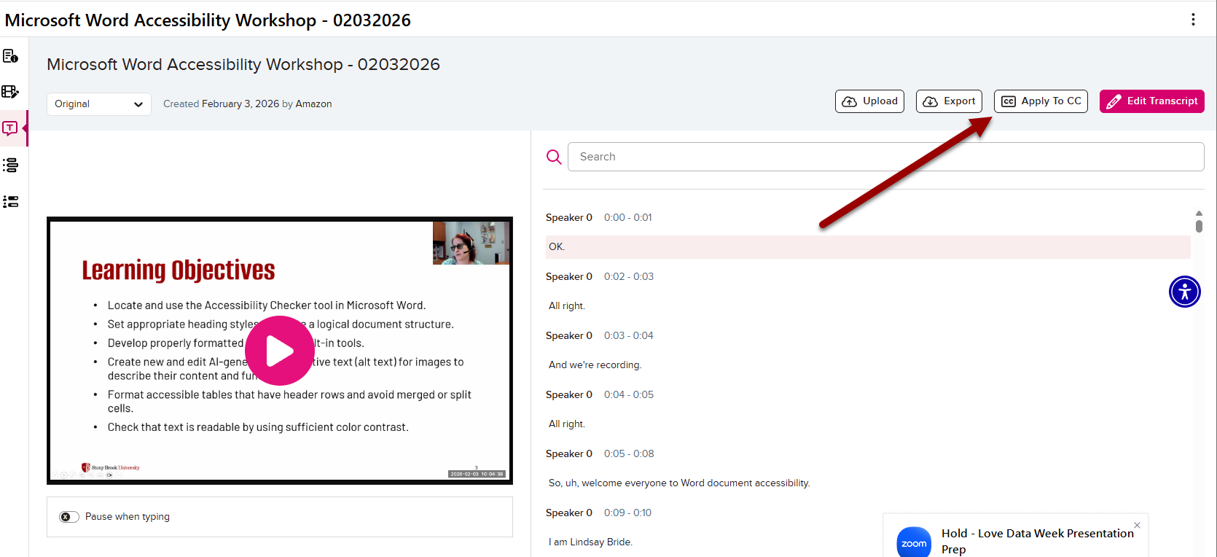
Where to Host Videos
Use Echo360, the university’s video hosting platform:
Transcripts are auto-generated for all videos and need to be checked for accuracy manually in the Edit Transcript menu.
Once you’ve checked your transcripts, you need to publish them by clicking the Apply to CC button.

Slide 32
Web & Third-party Content

Slide 33
Exceptions to Title II
Only Applies to Content Published Prior to April 2024 Rule
Sections of sites clearly identified as an "Archive" of old data.
  Example: a news article or press release published in 2018.
Pre-existing electronic documents no longer used by users.
  Examples: a flyer from a 2019 event.
Content posted by a third-party to an entity’s site.
  Example: a student posting to a discussion on Brightspace.
Password-protected Word, presentation, PDF, or spreadsheet files (does not apply to other file types or code).
  Example: a water bill in PDF format meant for a specific customer.
Pre-existing Social Media posts.
  Example: a tweet from 2017 about a class cancellation.
Notes:
Source: Civil Rights Division. (2024, April 8). Fact Sheet: New Rule on the Accessibility of Web Content and Mobile Apps Provided by State and Local Governments. U.S. Department of Justice. https://www.ada.gov/resources/2024-03-08-web-rule/.

Slide 34
Check Website Accessibility - Bookmarklets
A great resource to check for web accessibility is this bookmarklets webpage.
These allow testing for many specific elements of webpages, are free resources, and are easily activated.
Another great resource is NVDA screen reader software.
This software is a commonly used free screen reader that can be used for web accessibility testing.
Notes:
Source: Civil Rights Division. (2024, April 8). Fact Sheet: New Rule on the Accessibility of Web Content and Mobile Apps Provided by State and Local Governments. U.S. Department of Justice. https://www.ada.gov/resources/2024-03-08-web-rule/.

Slide 35
PDFs
An Adobe Acrobat Pro license is needed to fully remediate PDFs.
If possible, It is best to start with a fully accessible Microsoft Word or Google Doc file.
Utilize the built-in Accessibility checker within Acrobat Pro to flag and help remediate inaccessible PDFs.
Make sure to double check and manually test PDF's for accessibility after this process.
In the instance where an Adobe Acrobat pro license is not available, it is recommended to use Microsoft Word, Google Docs, HTML.
Notes:
Source: Civil Rights Division. (2024, April 8). Fact Sheet: New Rule on the Accessibility of Web Content and Mobile Apps Provided by State and Local Governments. U.S. Department of Justice. https://www.ada.gov/resources/2024-03-08-web-rule/.

Slide 36
EIT Review
All procurement of EIT goods and services or purchasing contracts with EIT vendors must reflect the University's commitment to accessibility.
This process covers both security and accessibility using the Accessibility and Cyber Risk Request form.
This procedure was implemented to help departments, so they do not have to submit information to two different groups.
Every person who creates, purchases, and or facilitates the use of EIT plays a role in ensuring accessibility for persons with disabilities.
Areas are encouraged to contact OEA for assistance in understanding their obligations related to compliance.
Notes:
Source: Civil Rights Division. (2024, April 8). Fact Sheet: New Rule on the Accessibility of Web Content and Mobile Apps Provided by State and Local Governments. U.S. Department of Justice. https://www.ada.gov/resources/2024-03-08-web-rule/.

Slide 37
AI
Any "one click" Artificial Intelligence solution is to be avoided, these are typically not reliable.
Stony Brook University has a current contract with Google Gemini for university use.
Gemini can be used for accessibility if needed, as long as the information produced is double checked and manually verified.
Arizona State University has an Image Accessibility Generator that uses AI to create alternate text for images.
This is a great tool to use as long as the produced images are also double checked and manually verified.
Notes:
Source: Civil Rights Division. (2024, April 8). Fact Sheet: New Rule on the Accessibility of Web Content and Mobile Apps Provided by State and Local Governments. U.S. Department of Justice. https://www.ada.gov/resources/2024-03-08-web-rule/.

Slide 38
Training Resources
Celt offers many Accessibility Resources and Supports through their website.
  These include Resource Guides on Digital Accessibility, Google Applications, Microsoft Applications, PDF's, and more.
OEA offers many trainings and courses through Deque University to aid in web accessibility.
  These include courses on Web Accessibility Testing, Google and Microsoft Applications, PDF's, and more.

Slide 39
CELT and OEA
The OEA Digital Accessibility Team. (Digital_Accessibility@stonybrook.edu) is available to answer any accessibility questions you may have
If you would like to request a consultation with a member of the Digital Accessibility Team, you can do so as well via a google form.
Lindsay.Bryde@stonybrook.edu.
Glenn.Dausch@stonybrook.edu.

