Slide 1
Musical Rhythm in Persian Poetic Meters
Ehsan Shafiee Zargar (University of Texas at Arlington) Hamed Rahmani (Radboud University Nijmegen)

Slide 2

Hamed Rahmani
Hamed Rahmani
PhD student of linguistics
Radboud University Nijmegen

Slide 3
Outline
An overview of Persian poetic meters
Short introduction to musical rhythm
Persian meters as rhythmic patterns
Rhythmic motives in Persian meters

Slide 4

An overview of Persian poetic meters

Slide 5
Persian Meters
Persian vowels

Slide 6
Persian Meters
Short (V) – æ, e, o
Persian vowels
Long (V:) – a, u, i Windfuhr (1979)

Slide 7
Persian Meters
Short (V) – æ, e, o
Persian vowels
Syllable structure
Long (V:) – a, u, i Windfuhr (1979)

Slide 8
Persian Meters
Short (V) – æ, e, o
Persian vowels
Syllable structure
CV(:)(C)(C)
Long (V:) – a, u, i Windfuhr (1979)
Darzi (1993)
CV (be)
CV: (bu)
CVC (bot)
CV:C (bid)
CVCC (bord)
CV:CC (bist)

Slide 9
Persian Meters
Short (V) – æ, e, o
Persian vowels
Syllable structure
CV(:)(C)(C)
Long (V:) – a, u, i Windfuhr (1979)
Darzi (1993)
CV (be)
CV: (bu)
CVC (bot)
CV:C (bid)
CVCC (bord)
CV:CC (bist)
light
heavy
superheavy

Slide 10
Persian Meters
Short (V) – æ, e, o
Persian vowels
Syllable structure
CV(:)(C)(C)
In terms of moraic structure (Hyman, 1985), Persian syllables can be divided into three classes of light (one mora), heavy (two moras) and superheavy (three moras) syllables.
Long (V:) – a, u, i Windfuhr (1979)
Darzi (1993)
CV (be)
CV: (bu)
CVC (bot)
CV:C (bid)
CVCC (bord)
CV:CC (bist)
light
heavy
superheavy

Slide 11
Persian Meters
Persian poetic meters are quantitative – metrical patterns are formed by following certain arrangements of light and heavy syllables.

Slide 12
Persian Meters
Persian poetic meters are quantitative – metrical patterns are formed by following certain arrangements of light and heavy syllables.
Example 1.
 | H | H | L | L | H | L | H | L | H | X
1st stanza | ʔej | nɑ: | me | to | beh | tæ | rin | sæ | rɑ: | ɣɑ:z
2nd stanza | bi: | nɑ: | me | to | nɑ: | me | kej | ko | næm | bɑ:z

Slide 13
Persian Meters
Persian poetic meters are quantitative – metrical patterns are formed by following certain arrangements of light and heavy syllables.
Example 1.
 | H | H | L | L | H | L | H | L | H | X
1st stanza | ʔej | nɑ: | me | to | beh | tæ | rin | sæ | rɑ: | ɣɑ:z
2nd stanza | bi: | nɑ: | me | to | nɑ: | me | kej | ko | næm | bɑ:z
/n/ is an exception: it doesn’t add to the weight of a long vowel.

Slide 14
Persian Meters
Persian poetic meters are quantitative – metrical patterns are formed by following certain arrangements of light and heavy syllables.
Example 1.
Example 2.
 | H | H | L | L | H | L | H | L | H | X
1st stanza | ʔej | nɑ: | me | to | beh | tæ | rin | sæ | rɑ: | ɣɑ:z
2nd stanza | bi: | nɑ: | me | to | nɑ: | me | kej | ko | næm | bɑ:z
 | H | H | L | L | H | H | H | L | L | X
1st stanza | tæl | xi: | næ | ko | næd | ʃi: | rin | zæ | qæ | næm
2nd stanza | xɑ: | li | næ | ko | næd | ʔæz | mej | dæ | hæ | næm

Slide 15
Persian Meters
Different metric patterns have been segmented and categorized in various ways.

Slide 16
Persian Meters
Different metric patterns have been segmented and categorized in various ways.
Traditionally, Al-Khalil’s (718-786) system of describing Arabic meters has been applied to Persian meters.
Each meter is composed of a certain pattern of “feet”.

Slide 17
Persian Meters
 | H | H | L | L | H | L | H | L | H | X
1st stanza | ʔej | nɑ: | me | to | beh | tæ | rin | sæ | rɑ: | ɣɑ:z
2nd stanza | bi: | nɑ: | me | to | nɑ: | me | kej | ko | næm | bɑ:z
 | H | H | L | L | H | H | H | L | L | X
1st stanza | tæl | xi: | næ | ko | næd | ʃi: | rin | zæ | qæ | næm
2nd stanza | xɑ: | li | næ | ko | næd | ʔæz | mej | dæ | hæ | næm

Slide 18
Persian Meters
Mæfʔulo
Mæfaʔelon
Mæfaʔil
 | H | H | L | L | H | L | H | L | H | X
1st stanza | ʔej | nɑ: | me | to | beh | tæ | rin | sæ | rɑ: | ɣɑ:z
2nd stanza | bi: | nɑ: | me | to | nɑ: | me | kej | ko | næm | bɑ:z
 | H | H | L | L | H | H | H | L | L | X
1st stanza | tæl | xi: | næ | ko | næd | ʃi: | rin | zæ | qæ | næm
2nd stanza | xɑ: | li | næ | ko | næd | ʔæz | mej | dæ | hæ | næm

Slide 19
Persian Meters
Mæfʔulo
Mæfaʔelon
Mæfaʔil
 | H | H | L | L | H | L | H | L | H | X
1st stanza | ʔej | nɑ: | me | to | beh | tæ | rin | sæ | rɑ: | ɣɑ:z
2nd stanza | bi: | nɑ: | me | to | nɑ: | me | kej | ko | næm | bɑ:z
Mostæfʔælæton
Mostæfʔælæton
 | H | H | L | L | H | H | H | L | L | X
1st stanza | tæl | xi: | næ | ko | næd | ʃi: | rin | zæ | qæ | næm
2nd stanza | xɑ: | li | næ | ko | næd | ʔæz | mej | dæ | hæ | næm

Slide 20
Persian Meters
Persian metric patterns have been segmented and categorized in a number of ways.
Traditionally, Al-Khalil’s (718-786) system of describing Arabic meters has been applied to Persian meters.
Each meter is composed of a certain pattern of “feet”.
Farzad (1967) categorized Persian meters into 32 feet (which may have 3, 4, 5 or 6 syllables). Each foot belongs to one of the three Hazaj, Ramal and Rajaz Arabic meters.

Slide 21
Persian Meters
Persian metric patterns have been segmented and categorized in a number of ways.
Traditionally, Al-Khalil’s (718-786) system of describing Arabic meters has been applied to Persian meters.
Each meter is composed of a certain pattern of “feet”.
Farzad (1967) categorized Persian meters into 32 feet (which may have 3, 4, 5 or 6 syllables). Each foot belongs to one of the three Hazaj, Ramal and Rajaz Arabic meters.
Elwell-Sutton (1976): since stress has no role in formation of metric patterns, we cannot really speak of feet, and the meters are simply defined as certain sequences of syllables.

Slide 22
Persian Meters
Intuitively, Persian meters are perceived to be “rhythmic”.

Slide 23
Persian Meters
Intuitively, Persian meters are perceived to be “rhythmic”.
Although Persian meters have been studied based on metrical properties of the language (e.g., Utas, 1994; Tabibzadeh, 2007), the intriguing correspondence of Persian poetic meters with musical rhythm has not been addressed.

Slide 24
Persian Meters
Intuitively, Persian meters are perceived to be “rhythmic”.
Although Persian meters have been studied based on metrical properties of the language (e.g., Utas, 1994; Tabibzadeh, 2007), the intriguing correspondence of Persian poetic meters with musical rhythm has not been addressed.
In the musical sense of the word, how rhythmic are Persian meters? How can musical rhythm be used to analyze and classify these meters?

Slide 25
Persian meters as rhythmic patterns

Slide 26
Metrical Structure and Rhythm
Metrical structure: Regular alternations of strong and weak beats (Lerdahl & Jackendoff, 1983).

Slide 27
Metrical Structure and Rhythm
Metrical structure: Regular alternations of strong and weak beats (Lerdahl & Jackendoff, 1983).
S-----w-----S-----w-----S-----w----- (A duple meter, e.g., 2/4)
S-----w-----w-----S-----w-----w----- (A triple meter, e.g., 3/4)
1
2
1
2
1
2
x
x
1
2
3
1
2
3

Slide 28
Metrical Structure and Rhythm
Metrical structure: Regular alternations of strong and weak beats (Lerdahl & Jackendoff, 1983).
S-----w-----S-----w-----S-----w----- (A duple meter, e.g., 2/4)
S-----w-----w-----S-----w-----w----- (A triple meter, e.g., 3/4)
In musical notation, beats are given a certain note value.
Note values are relative measures of duration.
1
2
1
2
1
2
x
x
1
2
3
1
2
3

Slide 29
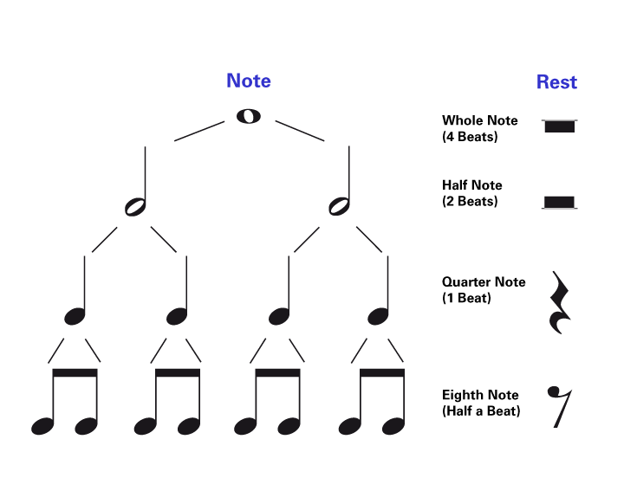
Metrical Structure and Rhythm
Whole
Half
Quarter
Eighth
Note values
Rests

Slide 30
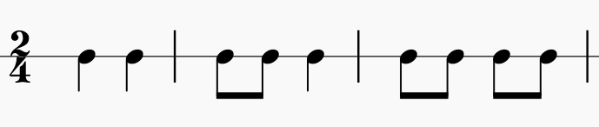
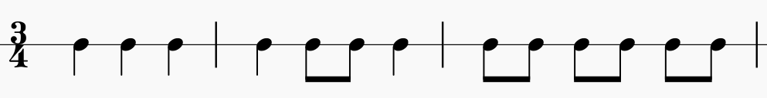
Metrical Structure and Rhythm
Whole
Half
Quarter
Eighth
Note values
Rests
1
2
1
2
1
2
1
2
3
1
2
3
1
2
3

Slide 31
Simple, Compound and Additive Meters
Simple meters: Each beat has binary subdivisions.

Slide 32
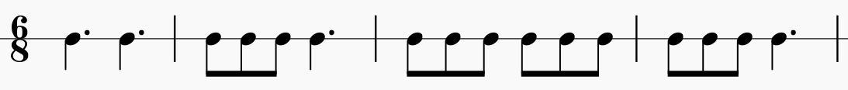
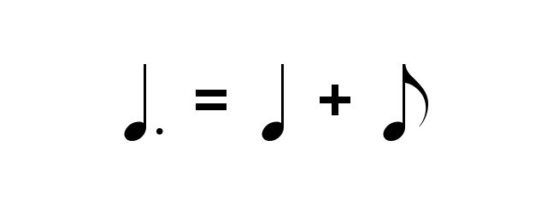
Simple, Compound and Additive Meters
Simple meters: Each beat has binary subdivisions.
Compound meters: Each beat has ternary subdivisions.
1
2
1
2
1
2
1
2

Slide 33
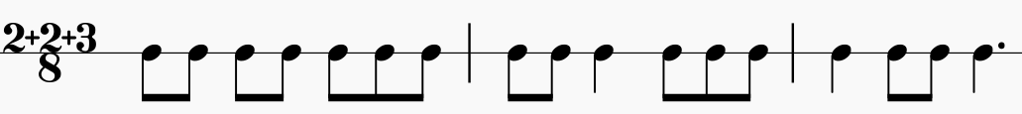
Simple, Compound and Additive Meters
Simple meters: Each beat has binary subdivisions.
Compound meters: Each beat has ternary subdivisions.
Additive meters: beat subdivisions are irregular.
1
2
1
2
1
2
1
2
1
2
3
1
2
3
1
2
3

Slide 34
From Syllables to Notes
The length of a syllable (in terms of moras) and the length of musical events (in terms of note durations) are both relatively defined.

Slide 35
From Syllables to Notes
The length of a syllable (in terms of moras) and the length of musical events (in terms of note durations) are both relatively defined.
How long is one mora (1μ)? It is half the duration of two moras (2μ).
How long is an eighth note (♪)? It is half the duration of a quarter note (♩).
Therefore, the three types of Persian syllables can be written as musical notes, e.g., by considering a mora to be an equivalent of a eighth note.

Slide 36
From Syllables to Notes
1μ = ♪
CV(:)(C)(C)
CV (be)
CV: (bu)
CVC (bot)
CV:C (bid)
CVCC (bord)
CV:CC (bist)
light
heavy
superheavy
♪
♩
♩.

Slide 37
Persian Meters as Rhythmic Patterns
Example 3. Traditional meter: moftæʔelon- moftæʔelon- moftæʔelon- moftæʔelon
mor | de | bo | dæm | zen | de | ʃo | dæm | ger | je | bo | dæm | xæn | de | ʃo | dæm
H | L | L | H | H | L | L | H | H | L | L | H | H | L | L | H

Slide 38
Persian Meters as Rhythmic Patterns
Example 3. Traditional meter: moftæʔelon- moftæʔelon- moftæʔelon- moftæʔelon
mor | de | bo | dæm | zen | de | ʃo | dæm | ger | je | bo | dæm | xæn | de | ʃo | dæm
H | L | L | H | H | L | L | H | H | L | L | H | H | L | L | H
♩ | ♪ | ♪ | ♩ | ♩ | ♪ | ♪ | ♩ | ♩ | ♪ | ♪ | ♩ | ♩ | ♪ | ♪ | ♩

Slide 39


Persian Meters as Rhythmic Patterns
Example 3. Traditional meter: moftæʔelon- moftæʔelon- moftæʔelon- moftæʔelon
mor | de | bo | dæm | zen | de | ʃo | dæm | ger | je | bo | dæm | xæn | de | ʃo | dæm
H | L | L | H | H | L | L | H | H | L | L | H | H | L | L | H
♩ | ♪ | ♪ | ♩ | ♩ | ♪ | ♪ | ♩ | ♩ | ♪ | ♪ | ♩ | ♩ | ♪ | ♪ | ♩

Slide 40
Persian Meters as Rhythmic Patterns
Example 4. Traditional meter: mostafʔælæton - mostafʔælæton
tæl | xi | næ | ko | næd | ʃi | rin | zæ | ɣæ | næm
H | H | L | L | H | H | H | L | L | H
♩ | ♩ | ♪ | ♪ | ♩ | ♩ | ♩ | ♪ | ♪ | ♩

Slide 41

Persian Meters as Rhythmic Patterns
Example 4. Traditional meter: mostafʔælæton - mostafʔælæton
tæl | xi | næ | ko | næd | ʃi | rin | zæ | ɣæ | næm
H | H | L | L | H | H | H | L | L | H
♩ | ♩ | ♪ | ♪ | ♩ | ♩ | ♩ | ♪ | ♪ | ♩

Slide 42
Persian Meters as Rhythmic Patterns
Example 5. Traditional meter: faʔelon - faʔelon - faʔelon - faʔelon
mæn | næ | xod | mi | ræ | væm | ?u | mæ | ra | mi | ke | ʃæd
H | L | H | H | L | H | H | L | H | H | L | H
♩ | ♪ | ♩ | ♩ | ♪ | ♩ | ♩ | ♪ | ♩ | ♩ | ♪ | ♩

Slide 43

Persian Meters as Rhythmic Patterns
Example 5. Traditional meter: faʔelon - faʔelon - faʔelon - faʔelon
mæn | næ | xod | mi | ræ | væm | ?u | mæ | ra | mi | ke | ʃæd
H | L | H | H | L | H | H | L | H | H | L | H
♩ | ♪ | ♩ | ♩ | ♪ | ♩ | ♩ | ♪ | ♩ | ♩ | ♪ | ♩

Slide 44
Persian Meters as Rhythmic Patterns
Example 6. Traditional meter: mostæfʔælon- mostæfʔælon- mostæfʔælon- mostæfʔælon
?ej | ka | re | van | ?a | hes | te | ran | ka | ra | me | dʒa | næm | mi | ræ | væd
H | H | L | H | H | H | L | H | H | H | L | H | H | H | L | H
♩ | ♩ | ♪ | ♩ | ♩ | ♩ | ♪ | ♩ | ♩ | ♩ | ♪ | ♩ | ♩ | ♩ | ♪ | ♩

Slide 45
Persian Meters as Rhythmic Patterns
Example 6. Traditional meter: mostæfʔælon- mostæfʔælon- mostæfʔælon- mostæfʔælon
?ej | ka | re | van | ?a | hes | te | ran | ka | ra | me | dʒa | næm | mi | ræ | væd
H | H | L | H | H | H | L | H | H | H | L | H | H | H | L | H
♩ | ♩ | ♪ | ♩ | ♩ | ♩ | ♪ | ♩ | ♩ | ♩ | ♪ | ♩ | ♩ | ♩ | ♪ | ♩

Slide 46






Persian Meters as Rhythmic Patterns
The analysis of 40 commonly used meters showed that these meters can be formed based on repetition of a small number of rhythmic motives.

Slide 47
Persian Meters as Rhythmic Patterns
No Change
mostafʔælon - mostafʔælon

Slide 48

Persian Meters as Rhythmic Patterns
faʔelaton - faʔelaton - faʔelaton - faʔelon

Slide 49
Persian Meters as Rhythmic Patterns
mæfaʔilon - mæfaʔilon - mæfaʔilon - mæfaʔilon

Slide 50

Persian Meters as Rhythmic Patterns
mæfaʔilon - mæfaʔilon - mæfaʔil

Slide 51

Persian Meters as Rhythmic Patterns
No Change
moftæʔelon - moftæʔelon - moftæʔelon - moftæʔelon

Slide 52

Persian Meters as Rhythmic Patterns
fæʔelaton - fæʔelaton - fæʔelon

Slide 53

Persian Meters as Rhythmic Patterns
No Change
moftæʔelon – mæfaʔelon - moftæʔelon – mæfaʔelon

Slide 54

Persian Meters as Rhythmic Patterns
fæʔelato - faʔelaton - fæʔelato - faʔelaton

Slide 55
Conclusions
Persian poetic meters can be analyzed as musical rhythmic patterns.
The basis for this analysis is to translate each syllable into a musical note based on its relative weight.
The rhythmic patterns corresponding to Persian poetic meters can be categorized into simple, compound and additive meters.
Most frequently used metric patterns can be generated by repetition of a small number of rhythmic motives.

Slide 56
Thank you!

