Slide 1




NACIL1, Stony Brook University, 28-30 April 2017 a three-dimensional approach to classification of Iran’s Languages
Erik Anonby
Carleton University & Universität Bamberg

Slide 2
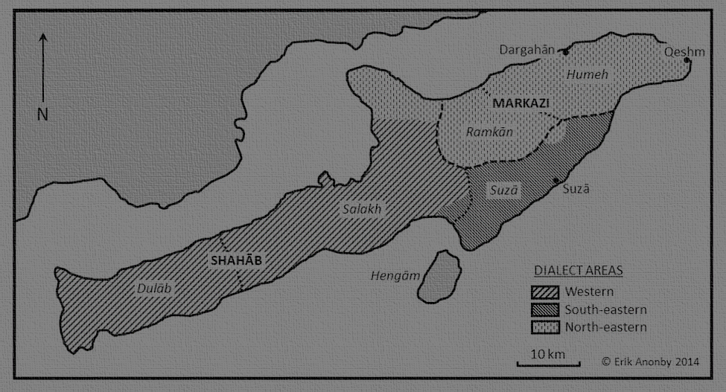
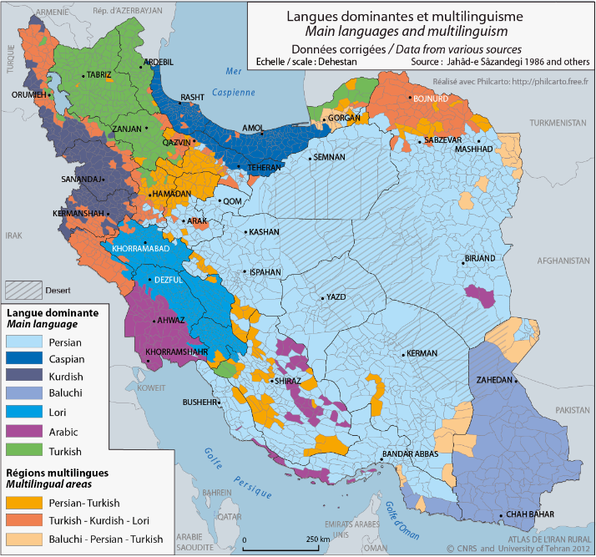
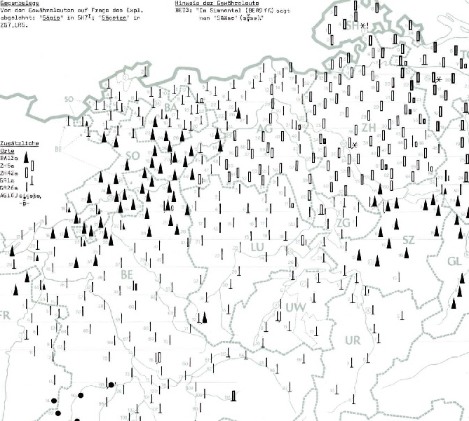
Introduction
Language atlases approach language mapping from two directions:
Distribution of language varieties in space
An account of linguistic forms associated with these varieties
Irancarto (Hourcade et al. 2012)
Sprachatlas der deutschen Schweiz
(Baumgartner et al. 1962-1997)

Slide 3
Language mapping
and atlases of Iran
History of efforts for an atlas of Iran’s languages
Important maps: Atlas Narodov Mira, TAVO, Izady, Irancarto, …
Reasons for lack of progress:
Complex language situation
Fragmentary documentation
Logistical problems
Shortcomings in research design
Unpublished results
Lack of consensus on listing and classification of languages

Slide 4
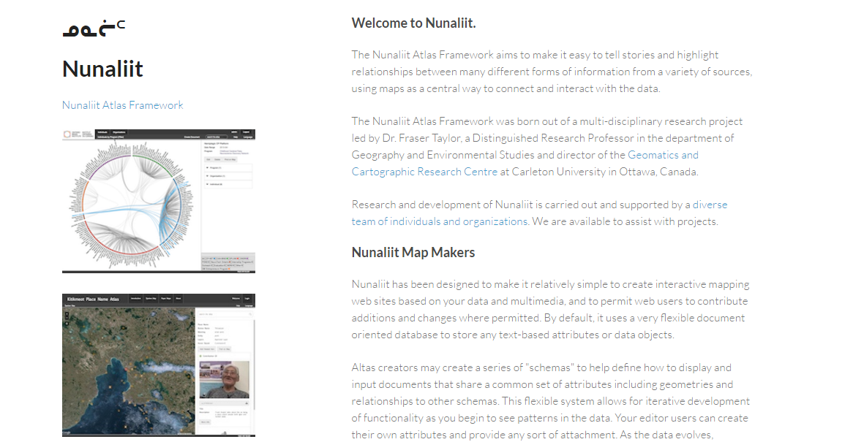
The Atlas of the Languages of Iran (ALI) research programme
Planning and progress
Open-source Nunaliit Atlas Framework
http://nunaliit.org
Research team
http://iranatlas.net/index.html?module=module.atlasteam
Province-level language distribution maps
http://iranatlas.net/index.html?module=module.language-distribution.kordestan
Atlas questionnaire
https://carleton.ca/iran/questionnaires
Language classification …

Slide 5
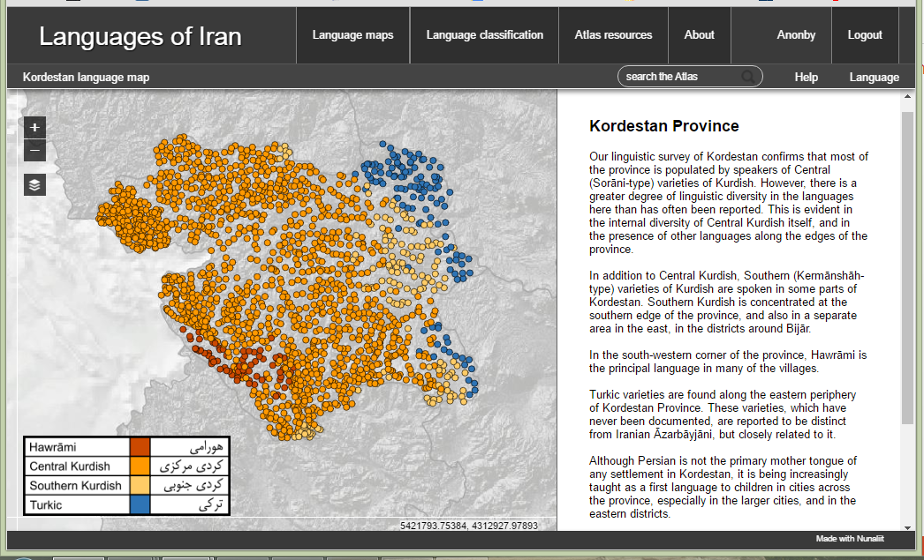
Research process

Slide 6
ALI classification research process

Slide 7
ALI classification research process
Inventory of language varieties
Traditional tree structure as a working classification
Backgrounding assessments of “language” vs. “dialect”
From 2D to 3D models of language classification
Differentiation and visualization of links between varieties

Slide 8
ALI classification research process
Inventory of language varieties
Traditional tree structure as a working classification
Backgrounding assessments of “language” vs. “dialect”
From 2D to 3D models of language classification
Differentiation and visualization of links between varieties
http://iranatlas.net/index.html?module=module.classification

Slide 9
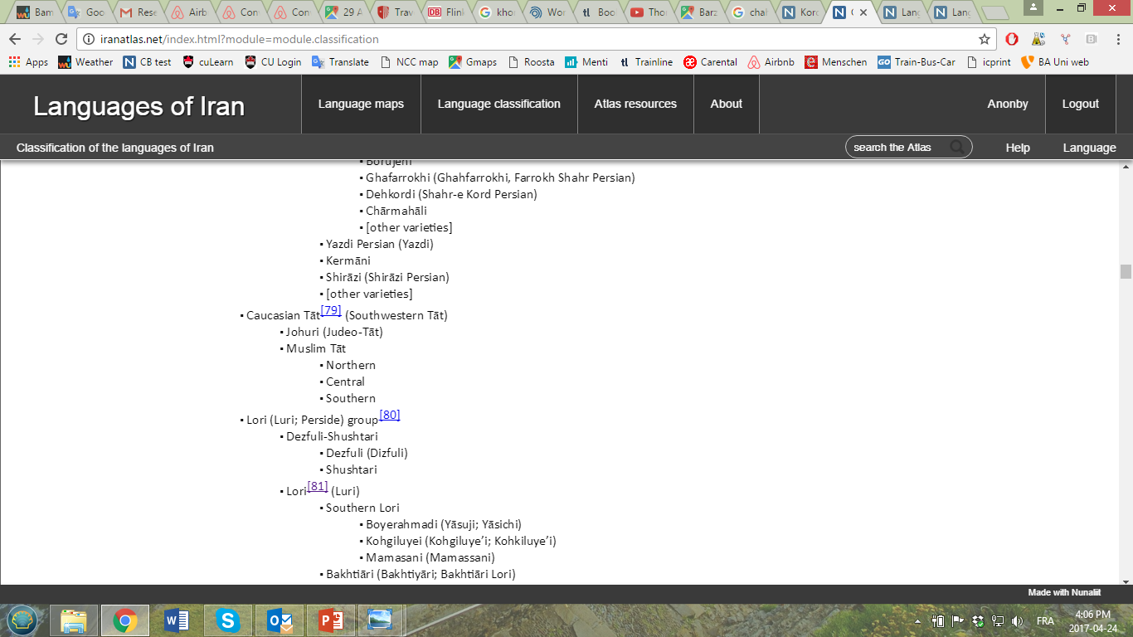

Slide 10
ALI classification research process
Inventory of language varieties
Traditional tree structure as a working classification
Backgrounding assessments of “language” vs. “dialect”
From 2D to 3D models of language classification
Differentiation and visualization of links between varieties

Slide 11
ALI classification research process
Inventory of language varieties
Traditional tree structure as a working classification
Backgrounding assessments of “language” vs. “dialect”
From 2D to 3D models of language classification
Differentiation and visualization of links between varieties

Slide 12
2D models of classification
(François 2014)
TREE
WAVE
WAVE (2)
“NeighborNet”
WAVE (3)
“Glottometic diagram”

Slide 13
ALI classification research process
Inventory of language varieties
Traditional tree structure as a working classification
Backgrounding assessments of “language” vs. “dialect”
From 2D to 3D models of language classification
Differentiation and visualization of links between varieties
http://iranatlas.net/index.html?module=module.taxonomy.selectMap_labelled#

Slide 14
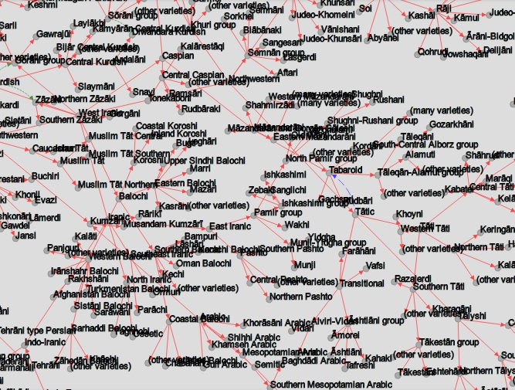

Slide 15
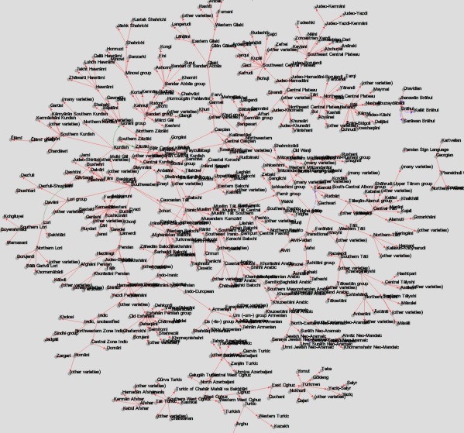

Slide 16
ALI classification research process
Inventory of language varieties
Traditional tree structure as a working classification
Backgrounding assessments of “language” vs. “dialect”
From 2D to 3D models of language classification
Differentiation and visualization of links between varieties
Relation through genealogical inheritance
Structural relation through contact
Relation through ethnic identification

Slide 17
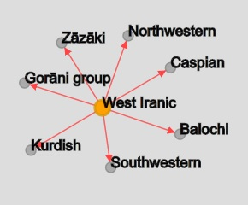
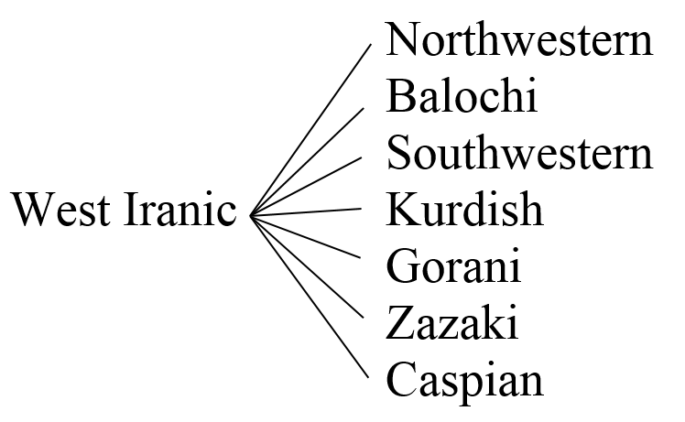
3D language relation web:
1. Relation through genealogical inheritance
http://iranatlas.net/index.html?module=module.taxonomy.selectMap_labelled#
cf. 2D tree structure

Slide 18
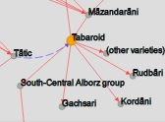
3D language relation web:
2. Structural relation through contact
Case study: Tabaroid (Borjian 2013, p.c. 2014; Stilo p.c. 2014)
http://iranatlas.net/index.html?module=module.taxonomy.selectMap

Slide 19
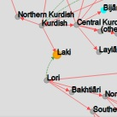
3D language relation web:
3. Relation through ethnic identification
Rarely acknowledged explicitly in the linguistic literature
Varies greatly between social groups and even individuals
Linguists try to use “objective” measures
However, ethnicity is a persistent determining factor in language classification, even among linguists
Assessments based on social considerations need to be made explicit
Case study: Laki
http://iranatlas.net/index.html?module=module.taxonomy.selectMap

Slide 20

Summary and reflection
A three-dimensional model addresses …
Non-linear ordering of language varieties
Transitional or mixed nature of some language varieties
Persistence of socially-based factors in determining language relations
Applications and prospects
Consistency in data management
Makes assumptions about language relations explicit
Dynamic relation of language relation web with language distribution and language data maps
Effects of individual and group taxonomies on the structure of language maps
Conclusion

