Slide 1

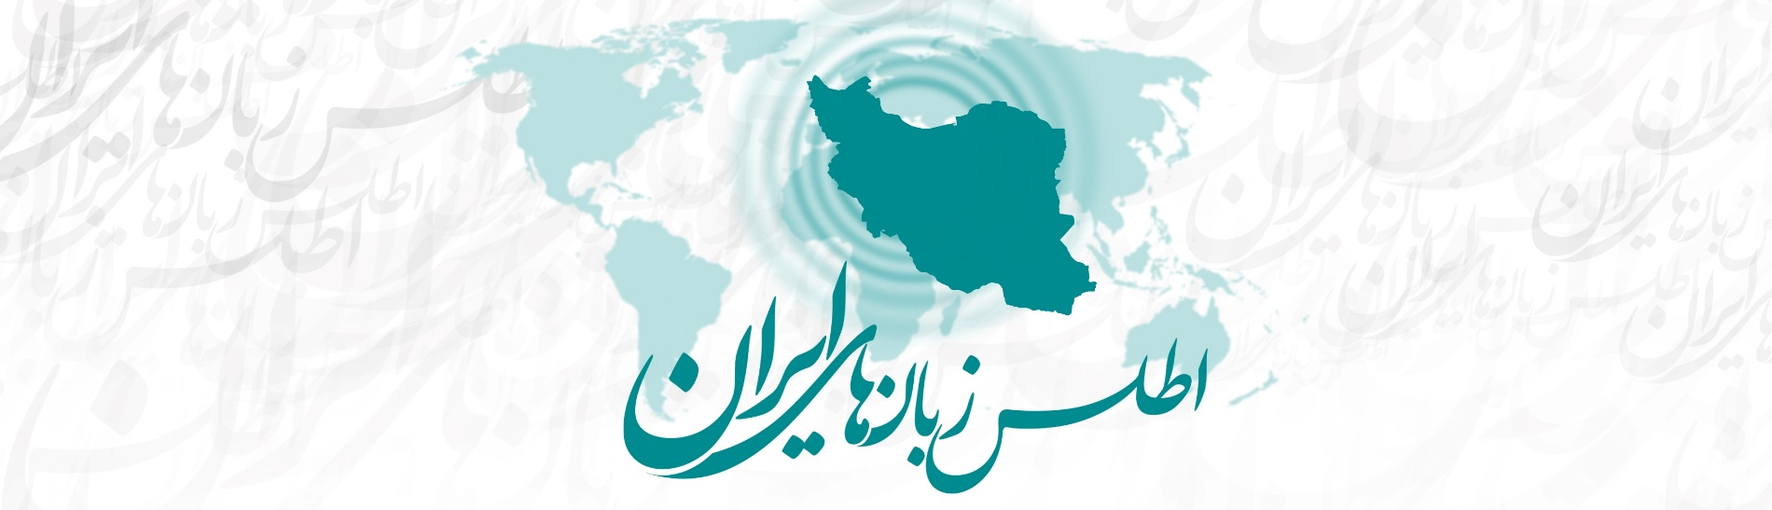



NACIL 2017 Stony Brook
Chahar Mahal va Bakhtiari Province in the Atlas of the Languages of Iran
Erik Anonby, Carleton University & Universität Bamberg
Mortaza Taheri-Ardali, Shahrekord University

Slide 2
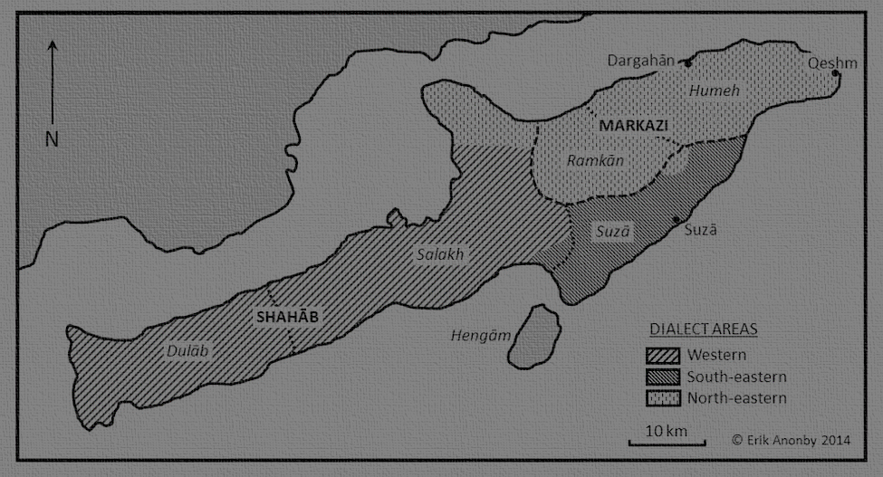
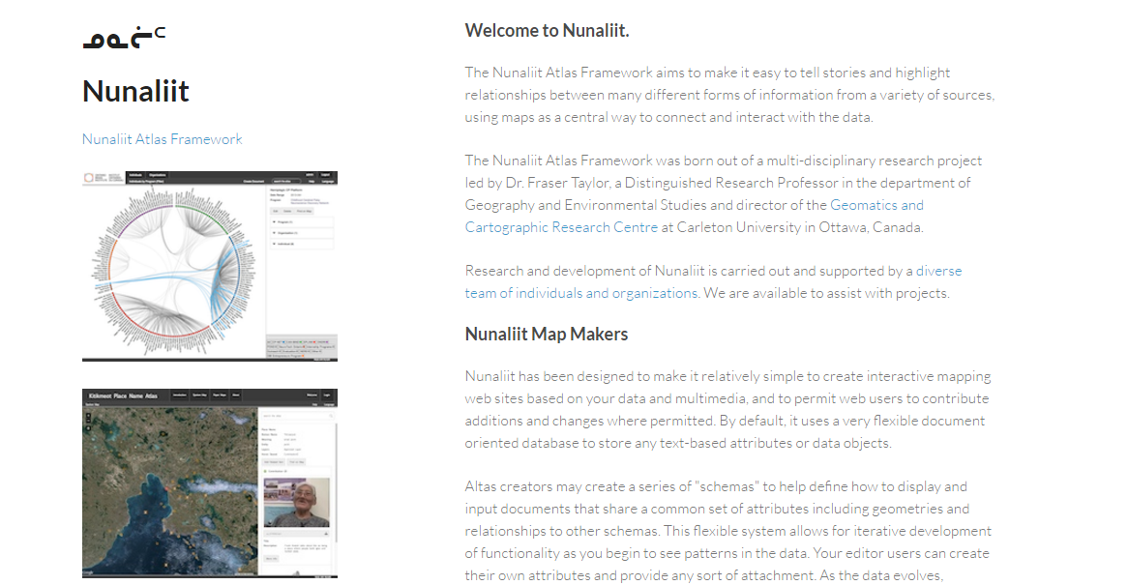
Introduction
The need for a language atlas for Iran
Research project: Atlas of the Languages of Iran (ALI) (test version: http://iranatlas.net)
Choice of Nunaliit Atlas Framework (http://nunaliit.org)

Slide 3
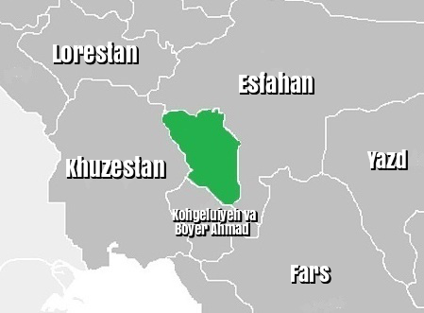
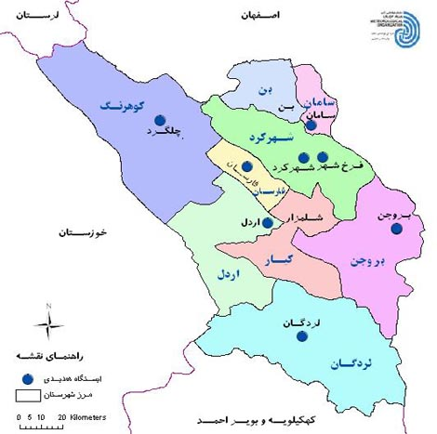
Research process
Chahar Mahal va Bakhtiari Province in its general context
Research goal: detailed, systematic study of language situation
Research team
  Erik Anonby (Carleton/GCRC/Bamberg) Project leader, Atlas editor, language data analysis
  Mortaza Taheri-Ardali (Shahrekord) Atlas team coordinator, C&B Province team leader, settlement localization, language data collection and analysis, Atlas bibliography
  Fraser Taylor (Carleton/GCRC) Project co-investigator
  Amos Hayes (GCRC) Geographic information technologist
  J.-P. Fiset (GCRC) Atlas programming
  Rob Oikle (Carleton/GCRC) Atlas design, map construction
  Laura Salisbury (Carleton/GCRC) Background map construction
  Mahnaz Talebi-Dastenaee (Alzahra) Settlement localization, language data collection
  Maryam Amani-Babadi (Payam-e Noor) Settlement localization, Atlas bibliography
  Peyman Pishyar (Allameh Tabataba’i) Language data collection
  Fatemeh Shahverdi (Tarbiat Modarres) Language data collection
  Reza Rezvani-Borujeni (Khomein Azad) Language data collection
  Elham Hasanpour (Esfahan-Khorasgan Azad) Atlas bibliography

Slide 4
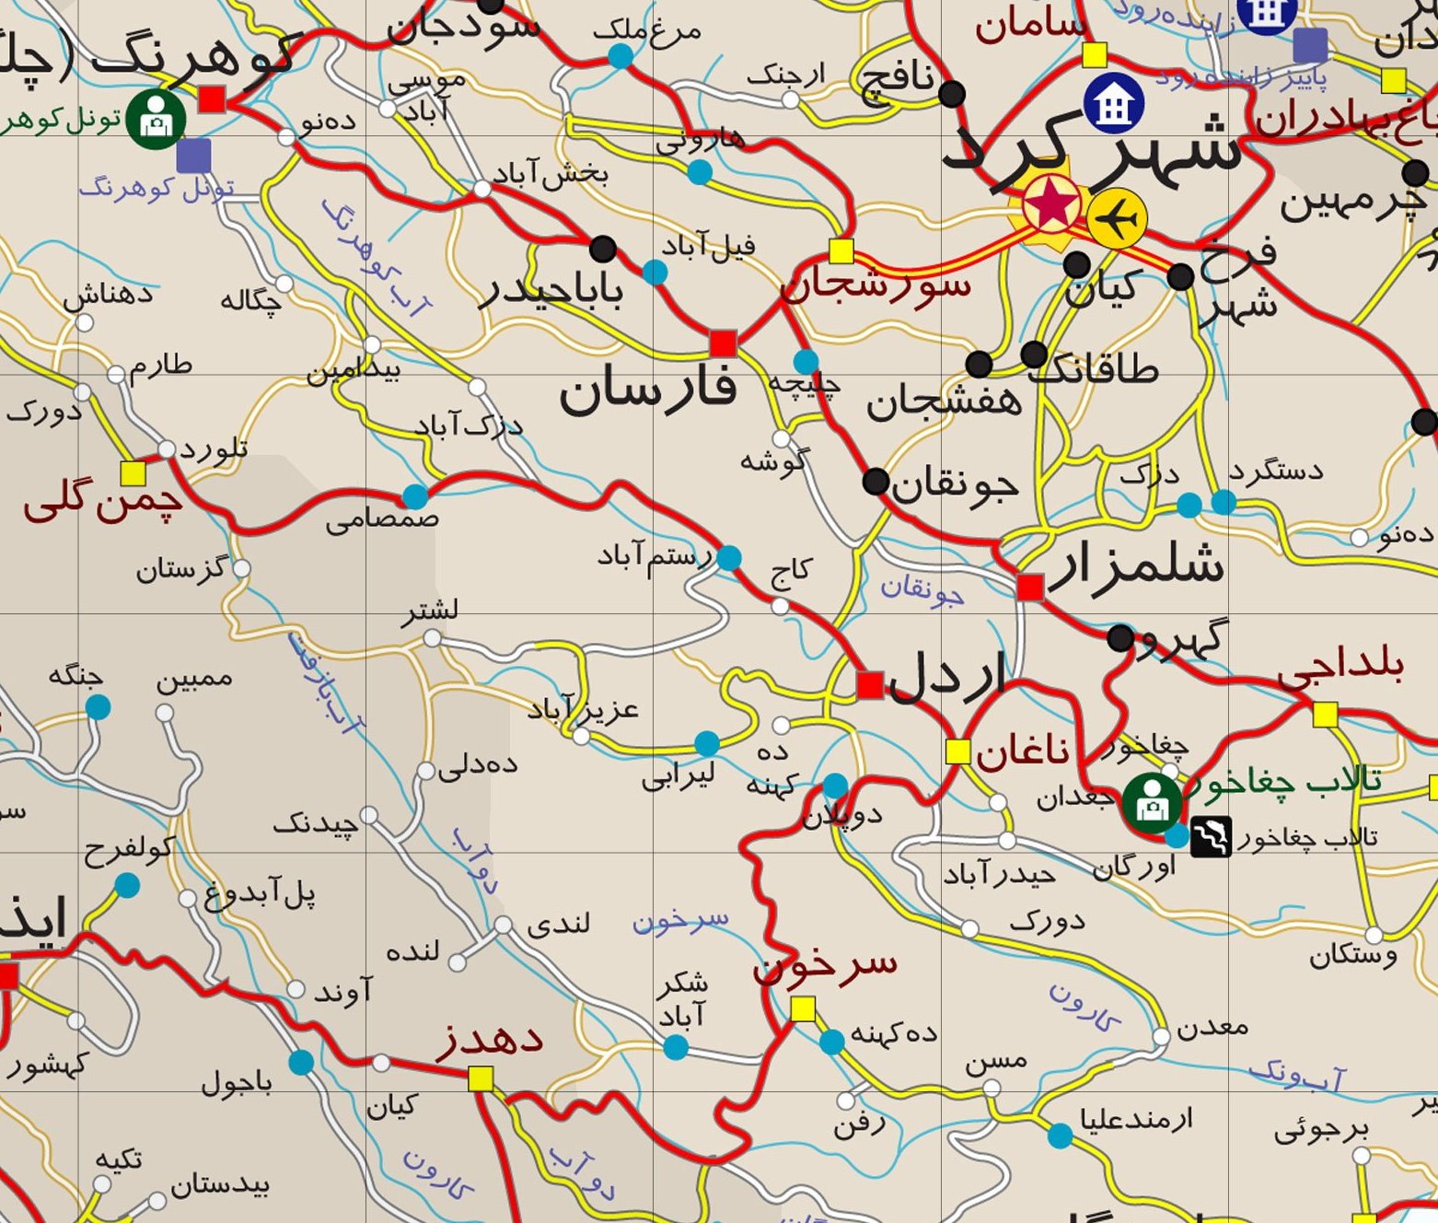
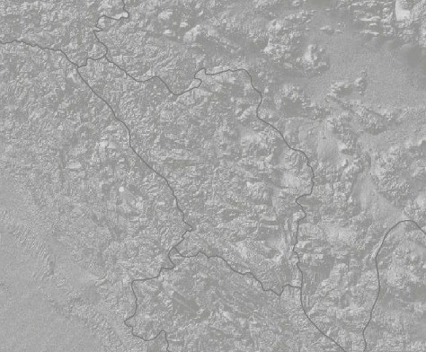
Research process
Chahar Mahal va Bakhtiari Province in its general context
Research goal: detailed, systematic study of language situation
Research team
Bringing together existing data sources

Slide 5
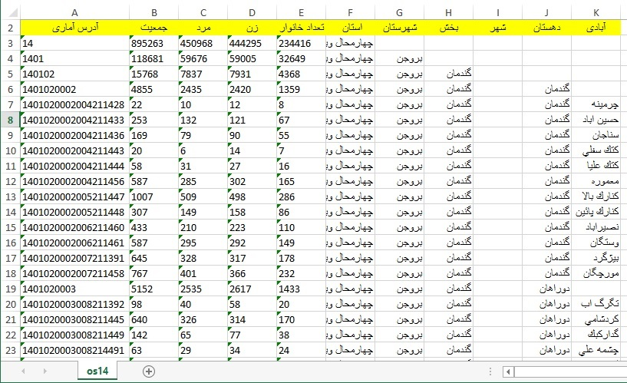
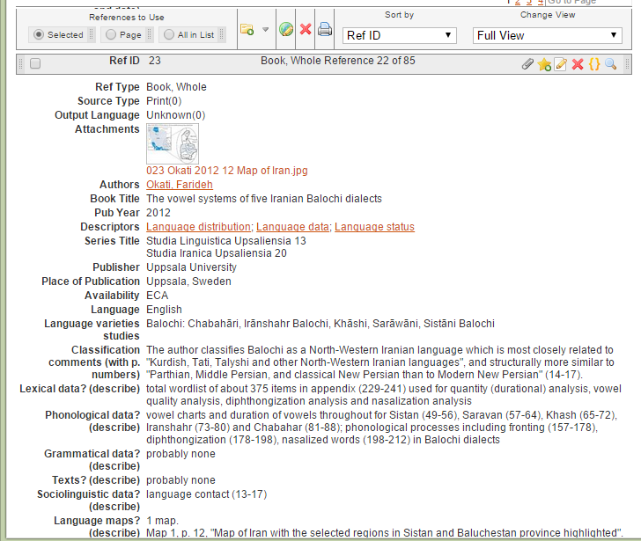
Research process
Chahar Mahal va Bakhtiari Province in its general context
Research goal: detailed, systematic study of language situation
Research team
Bringing together existing data sources
Collecting new data

Slide 6
Research process
Chahar Mahal va Bakhtiari Province in its general context
Research goal: detailed, systematic study of language situation
Research team
Bringing together existing data sources
Collecting new data
  Language distribution in each settlement
  Local pronunciations of place names
  Sources for data collection
Displaying the data
  http://iranatlas.net
  http://iranatlas.net/index.html?module=module.language-distribution.chahar_mahal_va_bakhtiari
  http://iranatlas.net/index.html?module=module.language-distribution.cbtest#

Slide 7
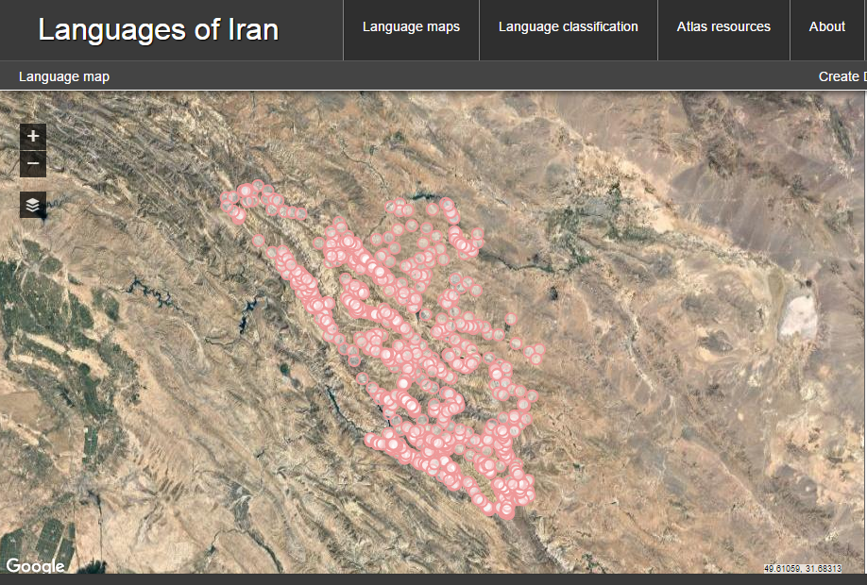
Research process

Slide 8
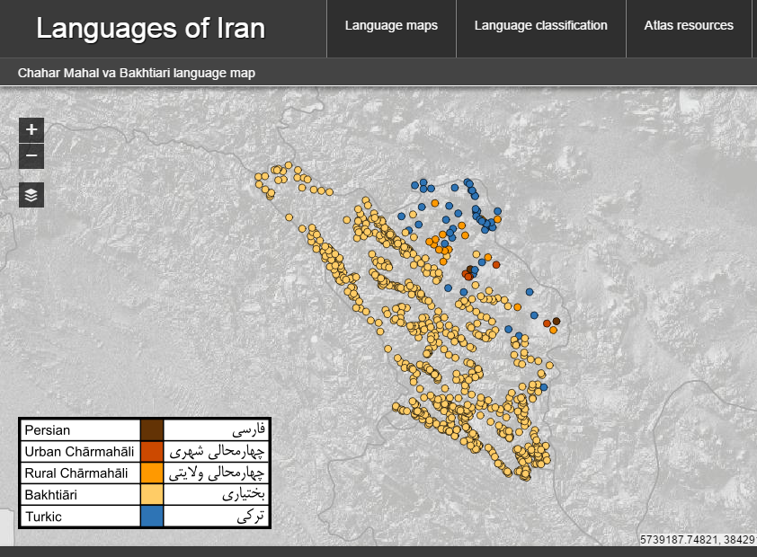

Slide 9
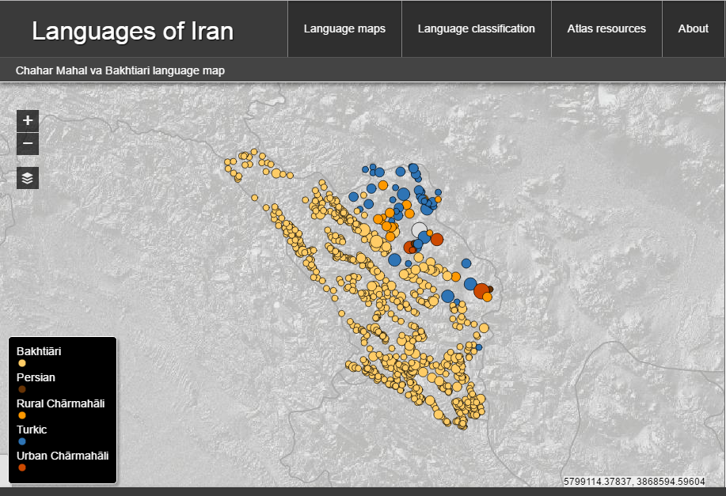

Slide 10
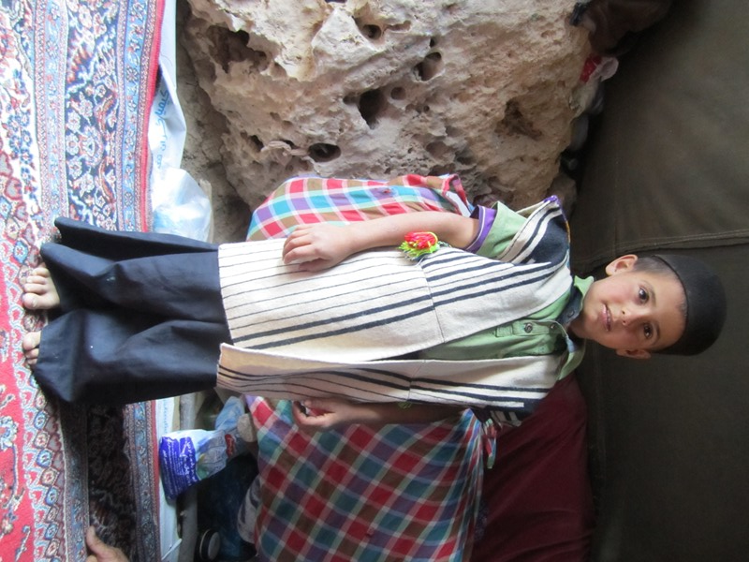
Results and challenges
Geographic distribution of language varieties
Nature of the language situation
Major language groupings
  Bakhtiāri
  Rural Chārmahāli
  Urban Chārmahāli
  Turkic
  Persian
Toward an account of geographic
distribution of linguistic features

Slide 11
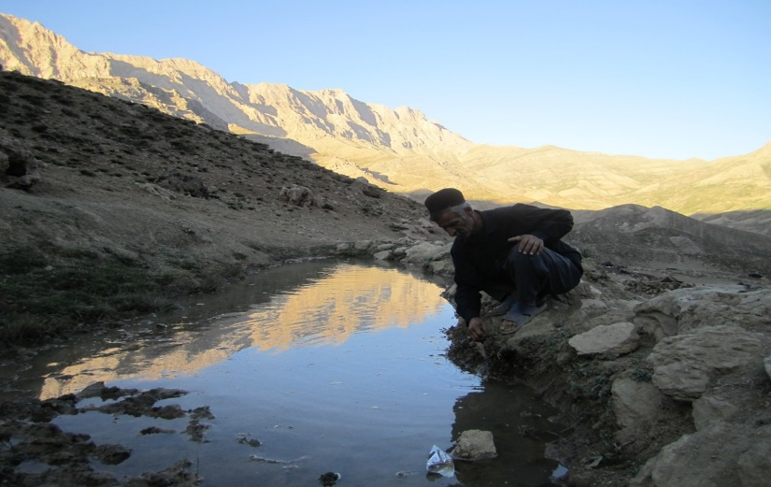
Conclusion
First detailed picture of language distribution in C&B Province
Initial understanding of dialect situation has guided choice of sites for collection of language data
Atlas questionnaire carried out in 25 of 35 locations
Currently analysing language data
Next steps
  Return to research sites to collect and analyze longer texts
  Prepare Atlas for submissions by scholars and Atlas users
  Generate language data maps
  Apply research process to other areas of Iran

