Slide 1


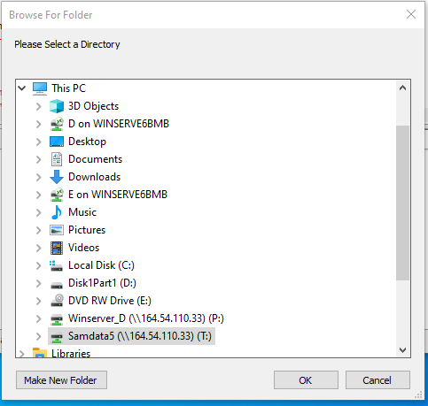
SinePumpII – Getting started
1a. Loading the program
On the desktop Double Click the IDL8.8 icon
Not the IDL8.8VM icon
1b. The MCA program will start by default and prompt to select a directory.
Click cancel.

Slide 2
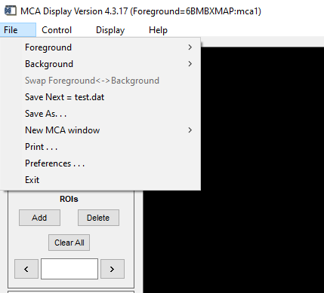
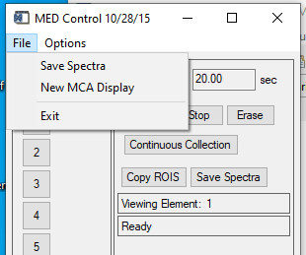
2. Exit out of two MCA windows

Slide 3
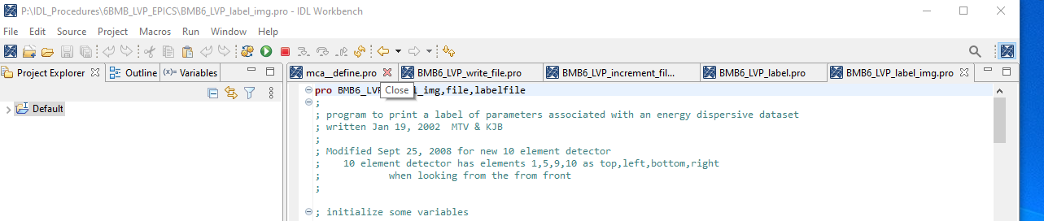
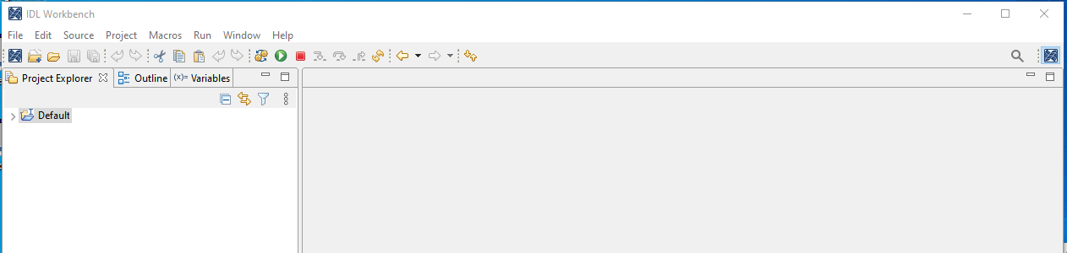
3. In the main IDL window Close all the programs that open. Select each program then Click the X
This is what you should have after all programs are closed.

Slide 4
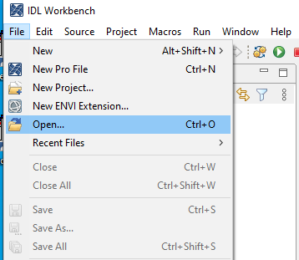
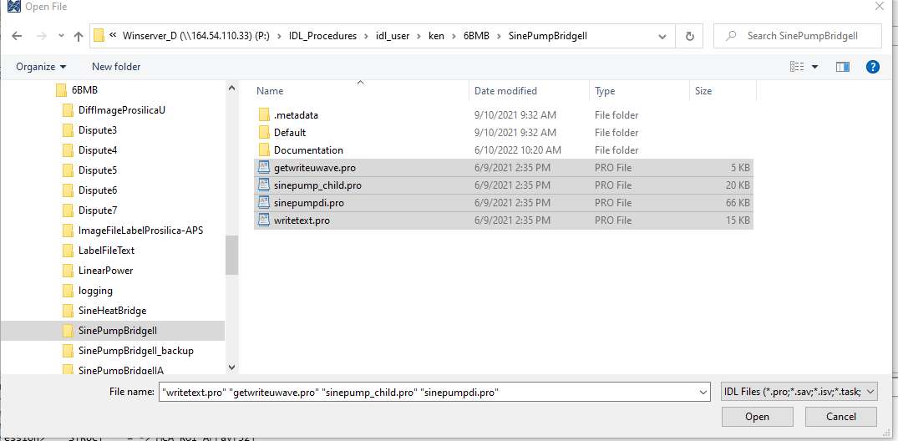
4. Open the SinePump programs
Navigate to P:\IDL_Procedures\idl_user\ken\6BMB\SinePumpBridgeII.
Select the four *.pro files. Click Open

Slide 5
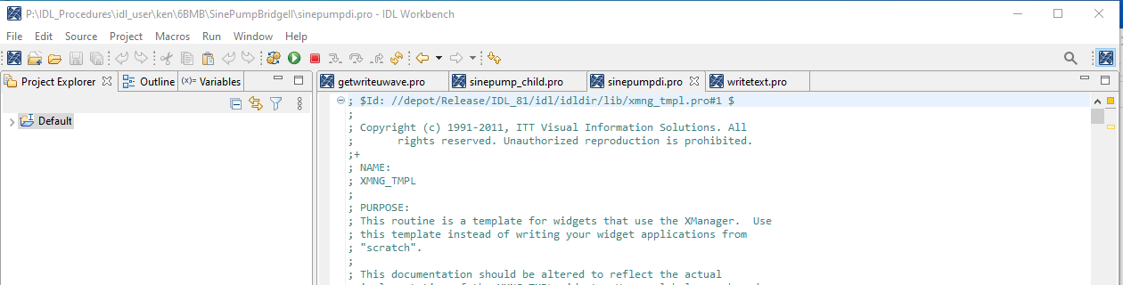
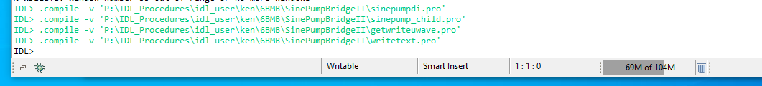
5. Compile the four *.pro files in this order: sinepumpdi, sinepump_child, getwriteuwave, writetext
Select each program click the Compile button. sinepumpdi has been selected.
All four programs have been compiled.

Slide 6
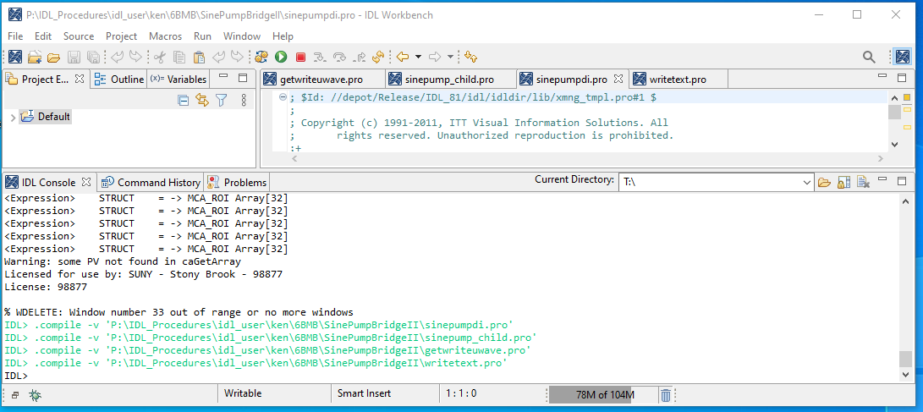
Run the program
1. Select sinepumpdi
2. Click the run button
NOTE: If the MCA program starts again repeat steps 1b, 2 and 3.

Slide 7
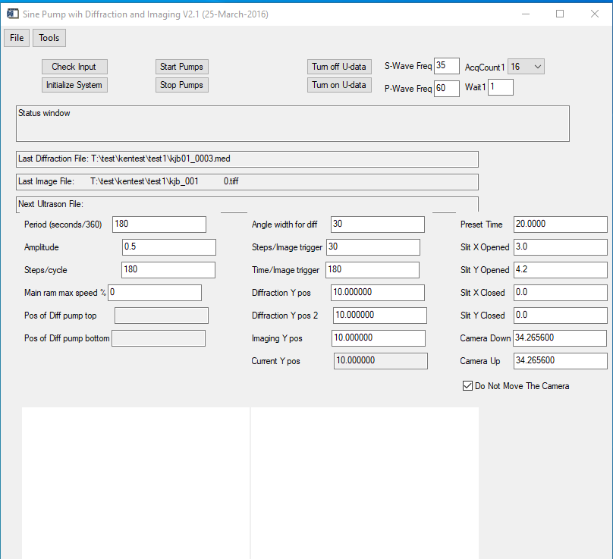
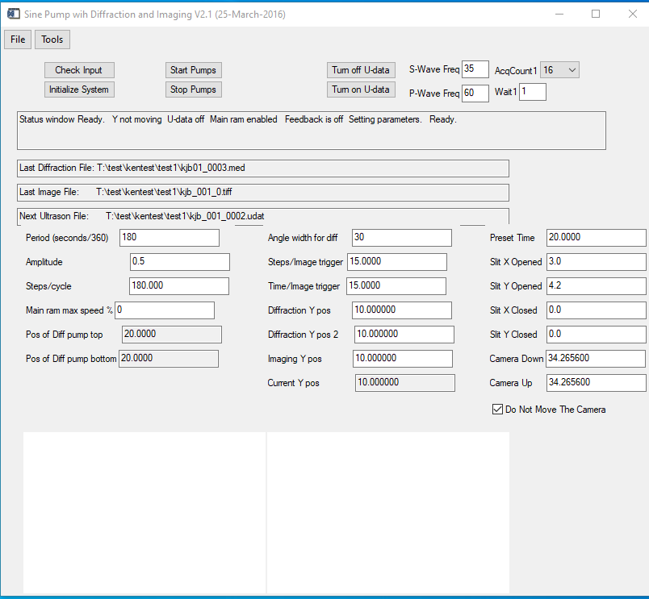
Once sinepump starts Click Check Input

