Slide 1


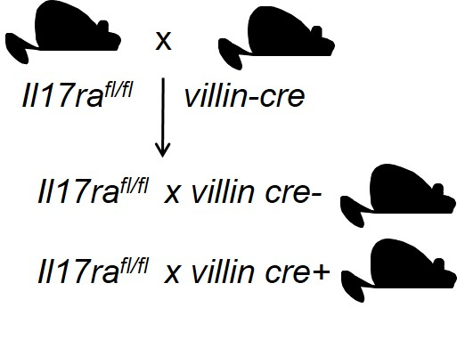
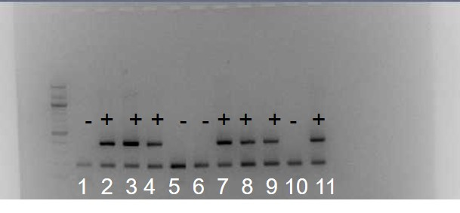

Author Names
Interleukin-17 and Gut Microbiota Axis In The Regulation of Metabolic Activities
¹Queensborough Community College, ²Molecular Genetics & Microbiology, Stony Brook University
Abstract
Methods
Figure 3: Bacterial Profiling for WT and gut specific KO mice before and after HFD
Non-alcoholic fatty liver diseases (NAFLD) is one of the major health problems in the developed countries. The exact cause of NAFLD is still unknown. Major risk factors contributing to NAFLD development include obesity, genetic predisposition, gut microbiota dysbiosis, pro-inflammatory mediators and insulin resistance. It has been demonstrated that interleukin 17A, (IL-17A), a pro-inflammatory cytokine, regulates gut microbiota and promotes the progression of NAFLD. However, how IL-17A modulates microbiota-dependent NAFLD development is unclear. We have recently reported that IL-17A plays an important role in regulating gut microbiota colonization as well as generation of microbiota-dependent pro-inflammatory immune responses. We propose the central hypothesis that intestinal IL-17A signaling maintains homeostatic host-microbiota interactions, and the abrogation of IL-17RA signaling in the gut contributes to commensal dysbiosis, dysregulated inflammatory responses and predisposition to NAFLD. To study that, we have generated gut and liver-specific IL-17RA knockout mice. Our data shows wild type mice gained more weight than gut specific IL-17RA KO mice. In line with the weight gain data glucose level was higher in WT than gut specific IL-17RA KO mice. Our finding suggest the gut microbiota particularly Firmicutes composition is altered in gut specific IL-17RA knockout mice.
Our data is useful to understand how intestinal IL-17A-dependent control of the gut microbiome regulates NAFLD, as this information will offer new therapeutic opportunities to treat liver diseases.
Mice: Our Lab generated gut and liver specific IL-17RA conditional knockout mice. They were generated by inserting lox-P flanked (flox) sequence for IL-17 receptor, and these were bread with other mice that expressed villin-cre recombinase (fig : 1).
High Fat Diet (HFD) experiment: Wild type and KO co-housed male mice were put on high fat diet. 60 kcal % fat was used to feed the HFD experimental group whereas 10 kcal% chow diets were used for the control group (fig: 2ab).
Blood glucose: Mice were fasted for 5 hours and then blood was collected. Blood glucose was measured using a glucometer (fig: 2c).
RT-PCR: bacterial profiling was done by performing RT-PCR on stool DNA from mice on HFD (fig: 3).
Results
Intestinal IL-17RA deficiency affects gut microbiota composition
Figure 1: Generation of gut and liver-specific IL17RA knockout mice
a
b
Discussion/Conclusion
Gut, but not liver IL-17 signaling, regulates HFD-induced NAFLD
Gut IL-17 signaling regulates Firmicutes, a major driver of obesity
Blood glucose level was lower in Gut-specific IL-17RA KO mice than in WT
Future Studies
Mice will be maintained on control diet
This experiment will be repeated with more mice
Histological examination on liver tissues will be performed in WT and gut-specific KO mice.
Insulin tolerance and glucose tolerance test will be done in WT and KO mice
Gut and liver specific immune responses will be investigated
Serum ALT will be measured to assess the amount of Liver damage
(A) Breeding strategy of IL-17ra Flox; Villin-cre mice
(B) Gel electrophoresis shows cre status of IL-17ra^{fl/fl} villin-cre mice
Introduction
Figure 2: Intestinal IL-17RA deficiency protects HFD-induced obesity
In humans, there are more than 100 trillion bacteria in our gut. Besides helping us digest fibers and prevent the colonization of other pathogens, gut microbiota also regulates development of immune cells. Gut microbiota particularly Segmented Filamentous Bacteria (SFB) has been shown to regulate Th17 cells (α,β T cells that secrete cytokine interleukin 17A) development. IL-17A signal is mediated through IL-17RA-RC receptor complex. IL-17A mainly activate non immune cells including epithelial and hepatocytes. IL-17A signaling in the gut epithelial cells induces antimicrobial peptides to fight off the expanding gut bacteria. Also, a dysregulated Th17 inflammatory immune responses against gut microbiota has been thought to play a critical role in many diseases including NAFLD Lee, 2015). More importantly, there is a big controversy about the role of IL-17A in NAFLD. Some research assert that IL-17 accelerates the progression of nonalcoholic fatty liver diseases in mice (Et al Hepatology. 2014). Others claim that IL-17 regulates adipogenesis, and obesity (Zuniga et al, 2010). Also, it is not clear whether IL-17A signaling in gut or liver modulates NAFLD and obesity. Therefore, to determine whether it occurs in the gut, or in the liver , our group generated gut and liver specific IL-17RA knockout mice.
a
b
something
important
References
Chen, Kong., Kolls, Jay K. "Interleukin-17A (IL17A)." ELSEVIER (2017): 8-14.
Doulberis, Michael., Kotronis, Georgios,. Gialamprinou, Dimitra., Kountouras, Jannis., Katsinelos, Panagiotis. "Non-alcoholic fatty liver disease: An update with special focus on the role of gut microbiota." ELSEVIER (2017): 182-172.
Et Al, Harley. "IL-17 signaling accelerates the progression of nonalcoholic fatty liver disease in mice." HEPATOLOGY AASLD (2014): 59.
Lee, Jacob S., Tato, Cristina M., Joyce-Shaikh, Barbara., McClanahan,Terrill K., Li, Xiaoxia., Cua, Daniel J. "Interleukin-23-Independent IL-17 Production Regulates Intestinal Epithelial Permeability." Immunity (2015): 727-738.
c
Acknowledgements
(A) Comparison of bodyweight gain in gut specific IL-17RA knockout mice and control cre- on normal chow or the HFD.
(B) Comparison of bodyweight gain in liver specific IL-17RA Flox; Albumin cre knockout mice and control littermate IL-17RA Flox mice.
(C) Blood Glucose level measurement on week 6 post HFD in IL-17RA Flox; villin-cre and littermate control cre- mice.

