Slide 1
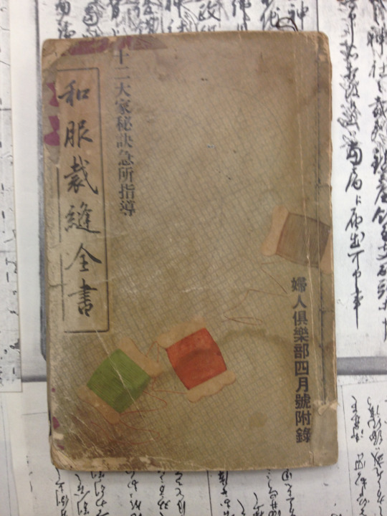
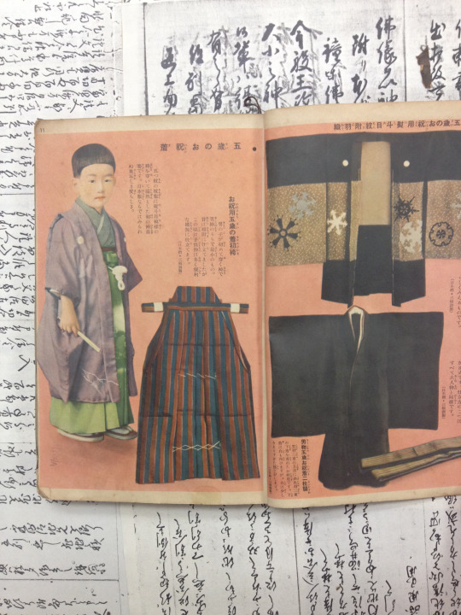
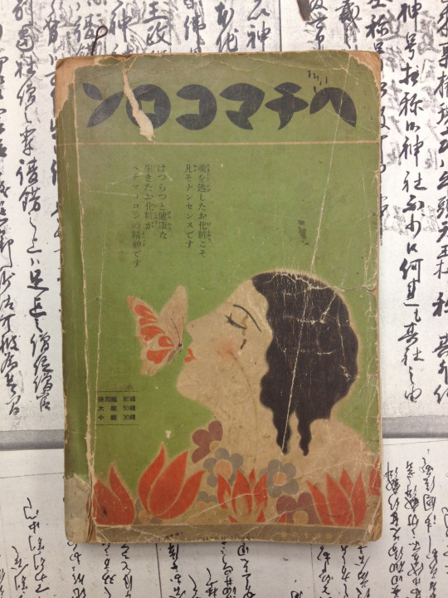
Wafuku Sewing 『和服裁縫全書』
Published by Kodansha in 1934 (a supplement of Fujin Kurabu 『婦人倶楽部』)
This book was published in 1934 Showa 9, but they are surprisingly easily-comprehensible. With illustrations and detailed guide, anyone could sew a wafuku and slip back in time to early Showa.

