Slide 1
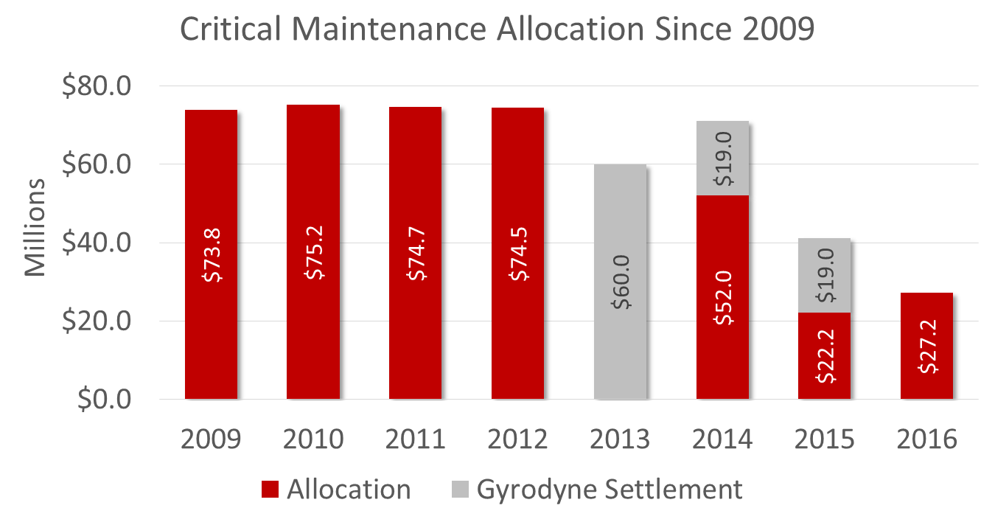
Fund SBU Critical Maintenance at $70M

