Slide 1
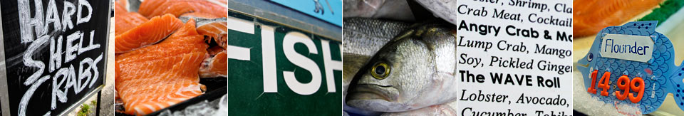
Recognizing and Preventing Overexposure to Methylmercury from Fish & Seafood Consumption: Information for Physicians
Photos by Jessica N. Warren
Adapted from manuscript of the same title published in the Journal of Toxicology, Volume 2011, Article ID 983072, doi: 10.1155/2011/983072

Slide 2
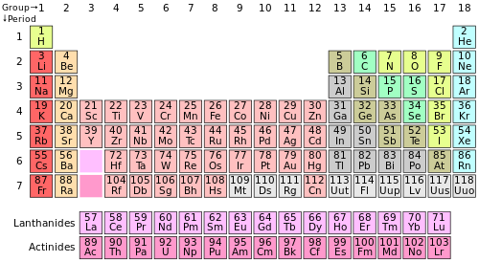
What is methylmercury?
All forms of mercury are toxic: elemental, inorganic, and organic forms.
Methylmercury,
is a major organic form and a potent neurotoxicant. We are exposed when we eat fish.
Table by DePiep, Wikemedia Commons
Hg-CH_{3,}
Hg

Slide 3
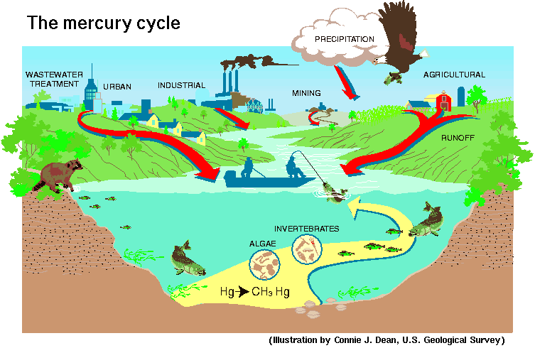
How does MeHg get into fish?

Slide 4
Formed in the Environment
Inorganic mercury enters the environment from a variety of natural and anthropogenic sources
Methylmercury is formed in the environment (in water bodies and wetlands) by micro-organisms that convert inorganic mercury to the organic (methylated) form.

Slide 5
Sources of Mercury
in the Environment
Current anthropogenic sources are primarily from coal burning and artisanal gold mining
Natural geological sources includes that from volcanoes
Re-emission of previously released mercury includes both anthropogenic and natural sources that has built up over decades and centuries in soils and oceans.
Information from the United Nations Environmental Programme report Global Mercury Assessment 2013

Slide 6
Mercury Sources in the Environment
Major anthropogenic sources are coal burning and artisanal gold mining
Cement kilns, chlor-alkalai plants, medical waste & fluorescent light bulbs are also sources
“Anthropogenic emissions and releases have doubled the amount of mercury in the top 100 meters of the world’s oceans in the last 100 years.” (UNEP Global Mercury Assessment 2013)

Slide 7

How does mercury get into fish?
Inorganic mercury enters aquatic systems from air and water discharges and natural sources
Some is methylated by microorganisms
MeHg accumulates and is biomagnified in the food chain
By far the biggest bioconcentration step is from water to phytoplankton (~10⁵ x)
Longest lived, predatory fish contain the highest levels
U.S. Environmental Protection Agency

Slide 8
What Happens in the Body When MeHg is Consumed?

Slide 9
Methylmercury in the Body
>95% of MeHg is absorbed in the gastrointestinal tract and distributed via the blood to all organs.
MeHg crosses the blood-brain barrier and about 10% of body burden is in the brain.
MeHg and demethylated (inorganic) mercury are gradually removed from the body, mainly via liver bile and feces.
MeHg is also excreted in urine, sweat and breast milk, and stored in hair and nails.

Slide 10
MeHg in the Body, continued
The half-life of MeHg in blood is about 50-70 days in adults (longer in neonates). I.e., once exposure ceases, the blood level decreases by about half, each 50-70 days.
MeHg crosses the placenta and the blood-brain barrier. Levels in umbilical cord blood are about 1.7x higher than maternal blood levels.

Slide 11
Clinical MeHg Poisoning
Some people eat a great deal of fish, as often as 5 to 20 meals per week.
Some fish lovers also prefer to eat predatory species like swordfish and tuna that contain high mercury levels.
Such individuals can get extraordinarily high doses of methylmercury from their diets, and some may develop clinical MeHg toxicity.
Cases of methylmercury poisoning are rare and most physicians have never encountered one; symptoms may easily go unrecognized unless dietary habits are considered.

Slide 12
Identifying Patients with MeHg Poisoning
Clinical manifestations vary with intensity and duration of exposure
Symptoms can vary significantly among individuals
Symptoms may be delayed from time of exposure
Symptoms may emerge when body’s ability to compensate for the damage is depleted
Genetic variation or food/nutrient interactions may affect mercury metabolism

Slide 13
(Nonspecific) symptoms associated with chronic lower level MeHg exposure:
sleep disturbance
headache
fatigue
difficulty concentrating
depression
memory loss
diminished fine motor coordination
muscle and joint pain
gastrointestinal upset
hair thinning
heart rate disturbance
hypertension
tremor
numbness or tingling around the mouth

Slide 14
Symptoms associated with higher MeHg exposures:
numbness or tingling in hands and feet
clumsy gait, difficulty walking (ataxia)
slurred speech
tunnel vision
diminished visual acuity
Symptoms from lower-level exposure list may (or may not) also be present

Slide 15
Variability of symptoms
Multiple research studies and personal observations by the authors indicate that individuals vary widely in sensitivity to MeHg toxicity.
Milder symptoms have been seen at relatively low blood mercury levels (e.g. 15-25 µg/L).
People vary in susceptibility to mercury, and not everyone with high exposure experiences adverse effects.

Slide 16
Minamata Disease
MeHg exposure occurred as a result of wastewater from acetaldehyde production released into Minamata Bay, Japan from 1932-1968
Health effects were devastating:
-Congenital Minamata Disease (extreme example): blindness, mental retardation, cerebral palsy
-Delayed development and impaired neurobehavioral performance
Adults Symptoms (Hair level > 20 ppm)
Tingling and paresthesias (lips, fingers)
Difficulty speaking
Tunnel Vision
Blindness, Coma, Convulsions, Death
Subclinical: no apparent effects

Slide 17
How much is too much MeHg?
In 1999 the US EPA established a reference dose (RfD) for methylmercury.
The RfD is designed to protect against the effects of methylmercury on prenatal brain development.
It represents a level of dietary exposure that should be safe for sensitive individuals.
It is expressed as micrograms of mercury per kilogram of body weight per day.
The EPA based the RfD on a 1997 study in the Faroe Islands.

Slide 18
The US Reference Dose
The prospective cohort study from the Faroe Islands showed a significant adverse effect on prenatal brain development at a fetal blood mercury level of 58 µg/L.
EPA applied a 10-fold “uncertainty factor” and estimated 5.8 µg/L to be a safe blood level.
Using a pharmacodynamic model, EPA set the RfD at a dietary intake of 0.1 µg mercury per kg body weight per day.
Corresponds to a blood level of 5.8 µg/L or a hair level of about 1 µg/g (or 1 ppm).

Slide 19
Limitations of the RfD
Research since 1999 has shown:
Umbilical cord blood mercury levels are higher than maternal blood levels by a factor of about 1.7X; thus the target level in maternal blood would be < 3.5 µg/L.
Several epidemiological studies since 2005 have now reported adverse effects of mercury on the developing brain at blood levels around or below the US RfD.

Slide 20
Our advice on using the RfD
For pregnant or breastfeeding women and children, the current RfD appears to offer no margin of safety. Advice should aim to keep women and children’s exposure well below the RfD.
There is no definition of “safe exposure” for non-pregnant adults who eat a great deal of fish and have elevated mercury exposure. For those populations, the current RfD is probably a sensible exposure limit.

Slide 21
Federal fish consumption advice
The US FDA and US EPA issued joint fish consumption advice in 2004.
The advice is aimed at women of childbearing age, pregnant and nursing women, and parents of young children.
The agencies encourage those populations to eat fish for its nutritional benefits, but also to be aware of the risks of MeHg exposure.

Slide 22
2004 EPA/FDA Advisory
Do not eat Shark, Swordfish, King Mackerel, or Tilefish, which contain very high levels of mercury.
Eat up to 12 ounces (2 average meals) a week of a variety of fish and shellfish that are lower in mercury.
Five of the most commonly eaten fish that are low in mercury are shrimp, canned light tuna, salmon, pollock, and catfish.
Albacore ("white") tuna has more mercury than canned light tuna. So, eat up to 6 ounces (one average meal) of albacore tuna per week.
Check local advisories about the safety of fish caught by family and friends in your local lakes, rivers, and coastal areas. If no advice is available, eat up to 6 ounces (one average meal) per week of fish you catch from local waters, but don't consume any other fish during that week.”

Slide 23
Limitations of the Advisory
Since 2004, research has shown substantial nutritional benefits to the developing brain from fish consumption during pregnancy.
Research in the same timeframe has shown adverse effects of mercury on brain development at levels far below what was recognized in 2004.
EPA/FDA are now updating the advisory to incorporate current perspectives on benefits and risks of fish consumption.

Slide 24
Case studies

Slide 25
Cases of MeHg Poisoning
A middle-aged company executive who ate about 14 fish meals per week, often choosing tuna and swordfish, experienced numbness around his mouth. About a year later he had trouble running, playing tennis and eventually walking. He underwent numerous tests but was not correctly diagnosed for several months. At that point his blood mercury level was 76 µg/L.
http://www.stonybrook.edu/commcms/gelfond/physicians/cases.html

Slide 26
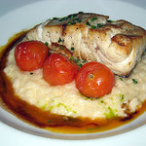
Cases of MeHg Poisoning
A 40-year-old lawyer who ate fish three or four times a week, primarily sea bass, could not sleep and lost his ability to concentrate.
His hair contained 13 ppm and his blood Hg level was 58 µg/L.
Photo by Ryosuke Hosoi

Slide 27
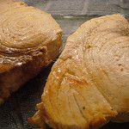
Cases of MeHg Poisoning
A middle-aged sales manager ate fish eight or nice times a week, usually choosing tuna, swordfish, halibut or sea bass. She experienced chronic fatigue, muscle aches, memory and concentration loss, and thinning of hair. When diagnosed, her blood mercury level was 76 µg/L.
Photo by Megan Chromik

Slide 28

Cases of MeHg Poisoning
A 66-year-old guitarist experienced a loss of fine motor coordination that affected her ability to play her instrument. She also had muscle weakness, thinning hair, and hand tremors. She had been eating swordfish and tuna steaks four to five times a week. Her blood mercury was 38 µg/L.
Photo by Daniel Panev

Slide 29

Cases of MeHg Poisoning
A 64-year-old anthropologist who ate fish nine times a week, often choosing tuna, swordfish, sea bass, and halibut, suffered from chronic fatigue, headaches, memory loss and hair loss. Her blood mercury level at diagnosis was 21 µg/L.
Photo by Pacificbro

Slide 30

Cases of MeHg Poisoning
A 10-year-old boy who had always been an “A” student began having problems concentrating and completing assignments in school. He lost his ability to catch a ball and developed hand tremors. He had eaten a can of tuna every day for a year. His blood mercury level was above 60 µg/L.
Photo by Jeffrey Beall

Slide 31
Medical Masquerade
To view a ‘grand rounds’ presentation on mercury exposure from seafood consumption given at Stony Brook University Medical Center in November, 2010, please see video at the following website: http://www.stonybrook.edu/commcms/gelfond/physicians/cases.html

Slide 32
Laboratory Tests
Blood mercury test should be done for patients with suspected elevated MeHg exposure from eating fish and shellfish. Blood mercury levels reflect recent exposures as well as chronic accumulation.
Hair may also be analyzed. Hair mercury levels reflect longer-term exposure and help to distinguish organic from inorganic or elemental mercury exposure.

Slide 33
Interpreting Test Results
Urine tests primarily reflect inorganic and elemental mercury exposures.
In general, a low urine mercury test (<10 µg/L) in combination with elevated blood (>5 µg/L) or hair (>1 µg/g) mercury points to MeHg exposure from seafood consumption.
Most clinical analyses of blood or hair are for total mercury; this is the appropriate measure for suspected exposure from seafood consumption and in the absence of unusual exposures to elemental or inorganic mercury.

Slide 34
Interpreting Test Results
Geometric mean blood levels in the USA based on NHANES data are:
< 1µg/L for ≤ 29 years of age
About 1µg/L for ≥ 30 years of age
Blood mercury levels tend to increase with age and peak in the 5th or 6th decade, depending on race and ethnicity.
Between 5-9 percent of women of childbearing age may have blood mercury levels above 5 µg/L (varies across the U.S. from region to region)
NYC Dept. Public Health study found 24% of women of childbearing age and 50% of Asians to have blood mercury levels above 5 µg/L.
Study of avid seafood consumers on Long Island (NY) found 42% over the RfD (geometric mean 4.6 µg/L)

Slide 35
Interpreting Blood or Hair Mercury Levels
The EPA has defined excessive blood mercury in women of childbearing age as 5.8 µg/L (which corresponds to about 1 µg/g in hair)
There is no comparable definition of acceptable blood or hair mercury in the rest of the population.
The Centers for Disease Control and Prevention define “excessive” mercury exposure as > 10 µg/L in blood
Many laboratories only report values > 10 µg/L, so blood mercury levels > EPA RfD (5.8 µg/L) might be missed.
Need to request labs to report results down to a detection level of <5 µg/L.

Slide 36
Interpreting Blood Mercury Levels
To protect against prenatal brain damage:
Research since the RfD was developed in 1999 suggests that there is no threshold for adverse effects of MeHg. Pregnant women should continue to eat fish but keep their mercury exposure as low as possible by choosing only low-Hg fish.
For all others:
The authors of this course believe a blood mercury level of ≥ 5 µg/L calls for counseling of patients regarding their fish consumption, emphasizing the need to choose low mercury species.

Slide 37
Interpreting Hair Mercury Levels
Most people have hair mercury levels well below 1 µg/g (1 ppm), the level in hair associated with the RfD.
For the USA the average is about 0.5 ppm
Different subgroups have higher levels of about 1 ppm
Neuropsychological functional deficits have been reported in adults with average hair levels of 4.2 ppm.
Prenatal neurodevelopmental effects have been associated with maternal hair levels of 1.2 ppm or higher.
Postnatal cognitive effects have been associated with child hair levels greater than 0.96 ppm.
Notes:
Health effect references not in original manuscript from which this presentation was developed.
Jedrychowski et al., 2006
Oken et al., 2005 and 2008
Lederman et al., 2008
Suzuki et al., 2010 Boucher et al., 2012
Sagiv et al 2012
Freire et al (2010)

Slide 38

Who is at risk?
Blood mercury levels are strongly correlated with fish consumption
Levels are higher in ethnic groups that eat more fish (Native American, Asian, Pacific Islanders)
Levels are higher among those with higher incomes
Levels are higher among those who live on the coasts
Photo by Susan M. Silbernagel
Notes:
References for this slide provided as it was not in original manuscript.
K.R. Mahaffey, R.P. Clickner and R.A.Jeffries, “Adult Women’s Blood Mercury Concentrations Vary Regionally in the U.S.: Association with Patterns of Fish Consumption (NHANES 1999-2004), 2009, Environ.Hlth.Persp., Vol. 117, 1, 47-53.
J.M. Hightower and D. Moore, “Mercury Levels in High-End Consumers of Fish”, 2003, Environ. Hlth. Perspect., 111,4, 604-608.
W.McKelvey, et al. “A Biomonitoring Study of lead, Cadmium, and Mercury in the Blood of New York City Adults”, 2007, Environmental Health Perspectives, vol. 115, 10. 1435-1441.

Slide 39
Recommended Action for Patients with High Blood or Hair Mercury
Stop eating fish temporarily or shift to very low-mercury fish.
Once blood mercury has declined to a lower level (<5 µg/L) and symptoms (if any) have resolved, low-mercury fish and shellfish can be reintroduced to the diet.

Slide 40
Is Chelation Recommended?
Chelation can be a valuable intervention for inorganic mercury poisoning, but it poses its own risks.
Except in rare cases, it is not generally warranted for patients with elevated MeHg from fish consumption.
Some practitioners mistakenly use DMSA or DMPS provocation challenge when they test a patient’s urine for mercury. This gives highly misleading results that overestimate mercury exposure.

Slide 41
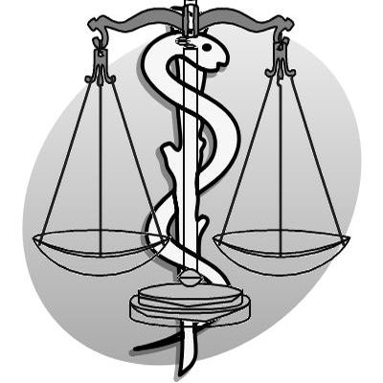
Benefits and Risks of Fish Consumption
By Partynia via Wikemedia Commons

Slide 42
Prenatal Benefits of Seafood Consumption
Fish consumption during pregnancy has nutritional benefits that improve cognitive performance in children of women who ate low-mercury fish during pregnancy.
Mothers-to-be should be encouraged to eat low-mercury fish.

Slide 43
Adverse Effects of MeHg Exposure
The developing nervous system is particularly vulnerable to MeHg. Effects depend on both the dose and timing of exposure.
Prenatal exposure can result in:
cognitive deficits
motor skill effects
attention deficits
language skill deficiencies
decreased learning capacity and memory

Slide 44
Adult Fish Consumption: Lifelong Benefits vs. Risks
Benefits (from nutrients in fish)
Improved blood lipid profiles
Lowered blood pressure
Improvements in rheumatoid arthritis
Prevention of macular degeneration
Improvements in neurological and psychological disorders such as depression and Parkinson’s
Possible decreased risk of heart disease
Risks (from MeHg and other contaminants)
Neurological effects of elevated MeHg exposure
Increased heart rate and blood pressure
Greater risk of myocardial infarction
May alter immune and/or endocrine system function

Slide 45
Populations at Risk
Methylmercury poses different risks to different people.
The fetus—prenatal brain development—is now thought to be the most sensitive population, so risk management targets pregnant women.
Young children’s developing brains are also at risk, so breastfeeding women and parents of children up to 12 years also need guidance.
People who eat a great deal of fish—more than two meals per week— or who favor top predator fish generally have higher exposure to MeHg and are at the greatest risk of harm.

Slide 46
Implications For Physicians
Physicians encounter methylmercury risk issues in two contexts:
They may need to advise pregnant women and parents of young children on ways to manage their MeHg exposure by choosing lower-mercury seafood.
They should routinely ask patients about their fish consumption and should consider MeHg as a possible cause of otherwise unexplained neurological symptoms in fish consumers who favor top predator/high mercury fish.

Slide 47
Prevention & Risk Communication– What to advise patients

Slide 48
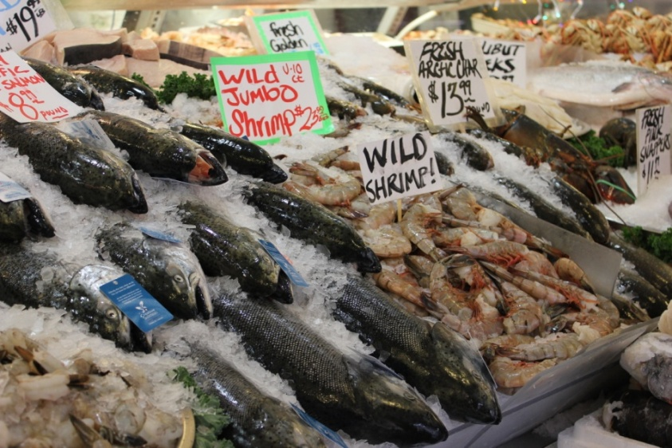
The key message:
The health benefits of eating seafood generally exceed the risks from MeHg as long as the fish consumed are mostly low in mercury.
Photo by Susan M. Silbernagel

Slide 49
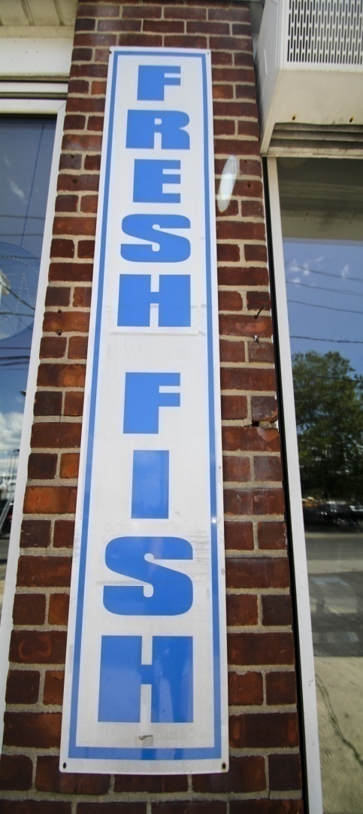
What to Advise Patients?
Fish is a good source of protein and is low in saturated fats.
Advise fish eaters to choose low-contaminant, high omega-3 fatty acid varieties, and to limit consumption of higher mercury fish.
Pregnant women, women who are breastfeeding, women who plan to be pregnant within a year, and children less than 12 years old should eat lowest mercury fish.
Photo by Jessica N. Warren

Slide 50
Other contaminants in fish
Fish also contain persistent organic pollutants (POPs) such as PCBs.
POPs have their own negative health effects that may offset some of the benefits of fish consumption.
Fat from pork, beef and chicken contain POPs at lower levels than in fish, but are consumed in greater quantities than fish.

Slide 51
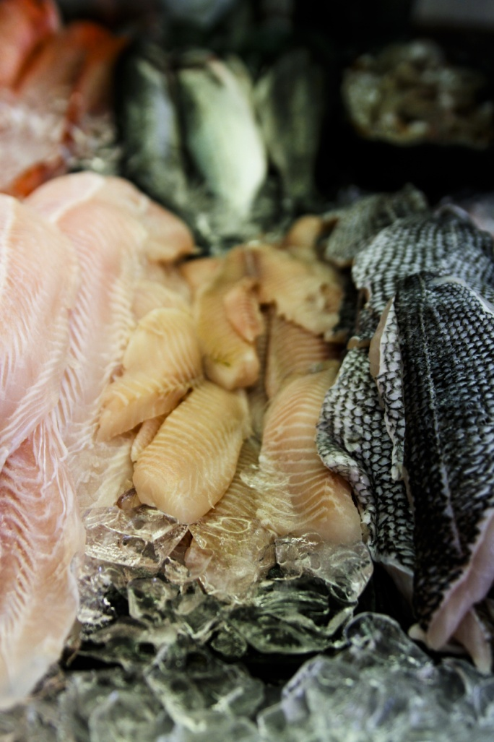
Can you avoid contaminants?
Mercury accumulates in fish muscle and levels are not reduced by cooking or preparation.
Persistent organic pollutants (POPs) like PCBs accumulate in fat and exposures can be decreased by removing skin and fatty tissue (darker color) and letting fat drip off during cooking.
Photo by Jessica N. Warren

Slide 52

How many fish meals per week?
MeHg dose depends on:
how often one eats fish
the portion size, and
the mercury content of the fish choice.
Also important:
individual health considerations such as pregnancy status.
Photo by Susan M. Silbernagel

Slide 53

How many fish meals per week?
USDA dietary guidelines recommend 2 meals per week (or about 8 ounces of seafood per week; less for children) of a variety of fish.
We note:
Mercury concentrations vary widely in fish
A 3 oz. serving of cooked fish fillet is about the size of a check book
Portion sizes for children are about 1 oz. per 20 pounds of body weight

Slide 54






Fish with Highest Mercury (species averages >0.8 ppm)
Bluefin Tuna Swordfish
King Mackerel
Shark
Mark Conlin
Gulf of Mexico Tilefish
Marlin
Adapted from Karimi et al, EHP (2012) and E. Groth III, Env. Research 110 (2010)

Slide 55




Fish with High Mercury (species averages >0.4 ppm)
Grouper
Orange Roughy
Spanish Mackerel
Bigeye Tuna
Adapted from Karimi et al, EHP (2012)and E. Groth III, Env. Research 110 (2010)
Notes:
Worth noting: Atlantic mackerel is a different species with much lower Hg 0.045 ppm.

Slide 56






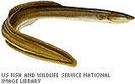
Fish with Moderately High Mercury (species averages >0.2 ppm)
Albacore Tuna
Wild Striped Bass
Bluefish
Yellowfin tuna
Halibut
Eel, American
American Lobster
Adapted from Karimi et al, EHP (2012) and E. Groth III, Env. Research 110 (2010)

Slide 57
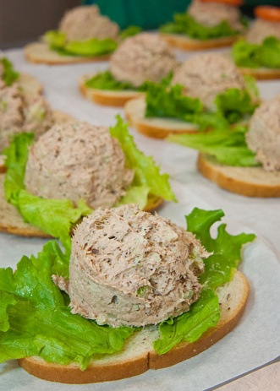
Canned tuna fish is the largest source of Americans’ MeHg exposure
Canned tuna accounts for 33% of total exposure. Chunk light tuna (average 0.12 ppm) has less mercury than albacore/“white” tuna (average 0.33 ppm)
Groth, E. III, “Ranking the contributions of commercial fish and shellfish varieties to mercury exposure in the United States: Implications for risk communication”, Environmental Research, 110 (2010) 226-236.
Karimi et al., “A Quantitative Synthesis of Mercury in Commercial Seafood and Implications for Exposure in the U.S.”, 2012, EHP.

Slide 58
Tuna used in sushi
Mercury levels of tuna used in sushi can range from 0.03 to 3.0 ppm depending on the species and size of the fish.
Yellowfin tuna in general has lower mercury levels than Bigeye or Bluefin tuna
A sushi-lover can easily consume 8 ounces per meal several times a week.
(Mercury levels in fish from Karimi et al, “A Quantitative Synthesis of Mercury in Commercial Seafood and Implications for Exposure in the U.S.”, 2012, EHP.)

Slide 59

Fish & Shellfish with Lowest Mercury (species averages ≤0.05 ppm) Pregnant women should look first to this list of species
Catfish (farmed)
Clams
Crawfish
☺ Herring (Atlantic)
Mullet
Mussels
☺ Oysters
Pollock (Pacific )
☺ Salmon
Scallops
Shrimp
Smelt
Squid
Tilapia (US; farmed)
☺ Trout (freshwater, farmed)
Whiting
☺ Indicates a good source of omega-3 fatty acids
Adapted from Karimi et al, EHP (2012) and E. Groth III, Env. Research 110 (2010)
Photo by Susan Silbernagel

Slide 60
Good News
Low mercury fish and shellfish (<0.08 ppm Hg) account for about 70 percent of the US seafood market.
Lowest-Hg (<0.05 ppm) varieties include many top-selling choices.
Consumers can easily find familiar, tasty and affordable low-mercury choices in local supermarkets.

Slide 61
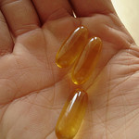
What about Contaminants in Fish Oil Supplements?
Some brands of supplements specify they are molecularly distilled or purified to remove contaminants.
Mercury is chemically bound to proteins and not fats and thus should not be present in fish oils.
POPs and halogenated natural products do accumulate in fish fats.
Lack of government standards on acceptable levels complicates the issue.
Prescription medicines are purified.
Photo by Stephen Cummings

Slide 62
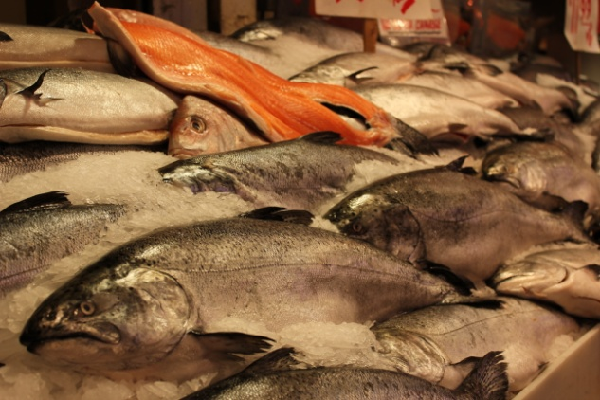
What about Contaminants in Fish Oil Supplements?
Based on current knowledge, the most prudent approach would be to consume a variety of low mercury fish rather than supplements.
If supplements are desired, those derived from small, cold water fatty fish such as anchovies, sardines and mackerel are reported to have lower levels of organic contaminants.
Photo by Susan M. Silbernagel

Slide 63

Sport Fish
Contaminants vary by location with sport caught fish.
Check local advisories. EPA website offers access to sport fish advisories across the U.S.
Photo by Fishingman1 from Wikemedia commons

Slide 64
Online Seafood Advice
Photos by Jessica N. Warren
Gelfond Fund for Mercury Research & Outreach website provides links to web resources for fish advice. http://www.stonybrook.edu/mercury

Slide 65
Online Seafood Advice
Environmental Defense Fund’s Seafood Selector offers the most comprehensive information and advice on commercial seafood.
Check state public health departments for sport fish advice.
Some state public health departments like CT and WA consider both Hg and POPs and both commercial fish and sport fish in their fish advice.

Slide 66
Online Hg calculators
Gotmercury.org and the Natural Resource Defense Council (www.nrdc.org) both offer calculators that estimate safe intakes of various fish based on their average MeHg content and the EPA RfD.
Due to variability in MeHg content and the scientifically dated nature of the RfD, on-line calculators should be used only as a general guide and not as an absolute indicator of safe fish servings.

Slide 67

Caution! All calculators are not equal
Howmuchfish.com denies and understates mercury risks and suggests fish serving sizes 10 times larger than the EPA RfD suggests is safe.

Slide 68
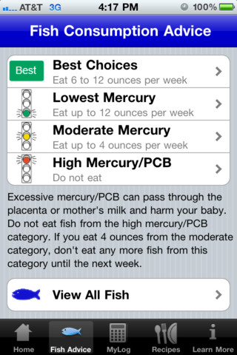
Iphone Applications
Fish4Health lists seafood choices by mercury content levels and allows user to tally type of fish and quantity consumed. It then calculates daily doses of mercury and omega-3 fatty acids.

Slide 69
Advice for Children
Environmental Defense Fund’s Seafood Selector is the most comprehensive source of seafood information and includes recommendations on how many meals of specific fish (and sushi) to eat each month to stay below the EPA RfD.
Sea Web Kid Safe Seafood offers information geared specifically for feeding children.
Children should be fed smaller portions (1 ounce per 20 pounds of body weight)
Until the RfD is reassessed these resources should be used only as general guidelines.

Slide 70
Photos by Jessica N. Warren
Stony Brook University’s Gelfond Fund for Mercury Research & Outreach website provides physician information and links to different web resources about the relationship of mercury and seafood consumption.
www.stonybrook.edu/mercury

